Slide 1

Healing and Wellness Workshop:
Alternative Approaches to Wellness
I’m not a doctor, so I don’t diagnosis conditions nor prescribe medications. This is an educational presentation on many of the Energy Healing Modalities and different approaches to Wellness. An opportunity to open your mind to different pathways to healing. No one path fits every person. This is a look into the many modalities. Whether you're dealing with chronic pain, cancer, or any one of the many autoimmune diseases, this looks at different Complementary and Alternative Medicine (CAM) practices and choices beyond mainstream medicine to add to your regimen. Come, let's explore the Healer within you!
Download at:
https://HelpHealYourself.net/workshops
Spiritual Development
By: Mario Grimes
Updated: 01/08/2026
Notes:
Mario's Resume:
EDUCATION/WORKSHOPS/CERTIFICATES:
March 2017: "Life Coaching Certification Program", with Peter Woodbury, Association For Research and Enlightenment, VA Beach, VA
March 2017: "The Beginner's Guide To Pendulum Healing", with Erich Hunter, app.ruzuku.com on-line course – 4 Hours
February 2017: "The Emotion Code", with Bradley Nelson, HealersLibrary.com on-line course – 9 Hours
June 2016: "Basic through Advanced Level Hypnotism" with Larry Lambert, Omni Hypnosis Training Center, Crofton, MD – 56 Hours
May 2016: “Reiki II (Second Degree)” with Menaka Quier, Reiki Master, Balanced Body Company, Newport News, VA – 12 Hours
April 2016: "Integrated Energy Therapy® Higher Steps To Transformation (Steps 8-14)", Hampton, VA – 14 Hours
February 2016: “Reiki I (First Degree)” with Menaka Quier, Reiki Master, Balanced Body Company, Newport News, VA – 12 Hours
October 2015: "Level III: The Reconnection-Certified Practitioner Program", McLean , VA – 16 Hours
June 2015: "Integrated Energy Therapy® Steps To Transformation (Steps 1-7)", Hampton, VA – 14 Hours
May 2015: “Level II: Reconnective Healing Foundational Practitioner Program”, Kripalu, MA – 19.5 Hours
April 2015: “Calming An Overactive Brain”, Institute For Brain Potential, Newport News, VA – 6 Hours
March 2015: “Integrated Energy Therapy® Master Instructor”, South Charleston, WV – 16 Hours
December 2014: "Integrated Energy Therapy® Advanced Level", Hampton, VA - 8 Hours
December 2014: "Integrated Energy Therapy® Intermediate Level", Hampton, VA - 8 Hours
November 2014: “Level I: Essentials of Reconnective Healing”, San Diego, CA – 19.5 Hours
July 2014: "Integrated Energy Therapy® Healing Angels of the Energy Field", Hampton, VA - 8 Hours
July 2014: "Integrated Energy Therapy® Basic Level", Hampton, VA - 8 Hours
January 2007: "Bachelor of Science in Computer Information System (Cum Laude)", Saint Leo University, Florida campus at Langley AFB, VA
​
WORK EXPERIENCE:
January 2015 — December 2019: Help Heal Yourself!, Certified Hypnotist, Life Coach, The Emotion Code Certified Practitioner, Reconnection-Certified Practitioner (Level III), Master IET® Instructor and Practitioner
August 2013 — January 2015: CGI Federal (DOD Contractor), Scenario Developer
August 2012 — June 2013: Cubic Applications (DOD Contractor), Army Training Help Desk Shift Manager
September 2010 — March 2012: Cubic Application (DOD Contractor), Convoy Simulation Scenario Writer/Developer and Instructor
October 2009 — September 2010: General Dynamics Information Technology (DOD Contractor), Training Specialist
February 2007 — October 2009: General Dynamics Information Technology (DOD Contractor), Functional Associate Analyst
October 1980 — October 2001: United States Air Force, 12 years Aerospace Photographic Systems Technician and 10 years Nutritional Medicine Element, Retired as Master Sergeant (E-7)
March 1979 — October 1980: Virginia Air National Guard, Aerospace Photographic System Repairmen
​
PROFESSIONAL ORGANIZATIONS:
Christian National Church, Ordained Christian Minister (Lic# 98166071, Issued 11 Aug 2013)
Fellowship Of Christian Hypnotists, Certified Christian Hypnotherapist (since August 2016)
National Board of Hypnosis Education and Certification — Omni Hypnosis Training Center, Board Certified Hypnotist
National Guild of Hypnotists, Inc, Certified Hypnotist, Valued Professional Member (since 2016)

Slide 2
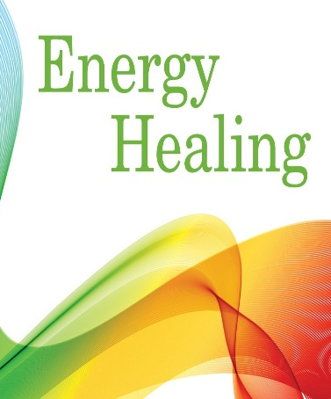
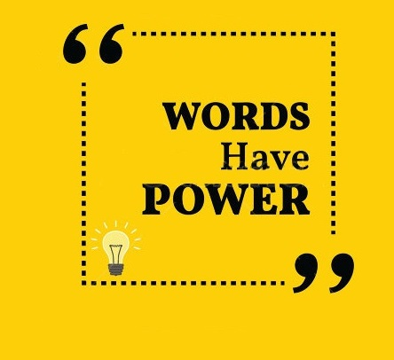
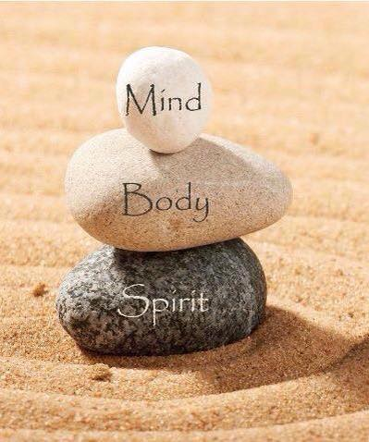
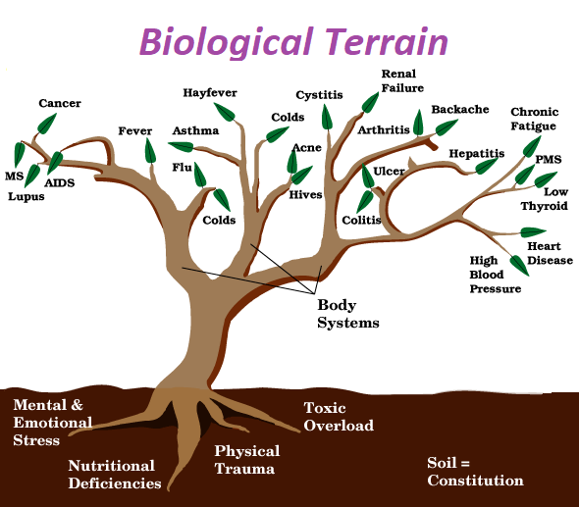
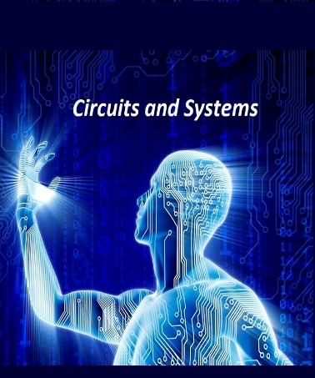
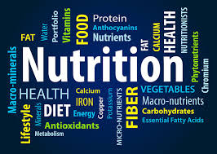
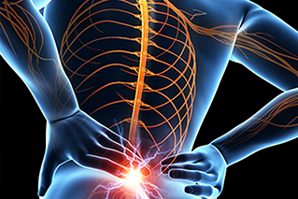
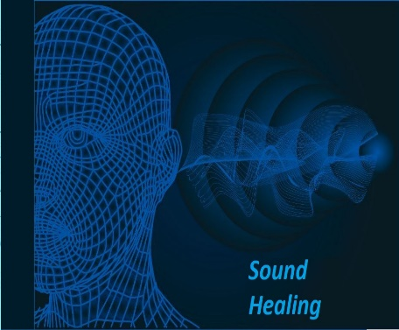
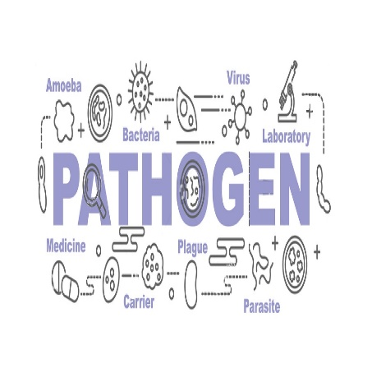
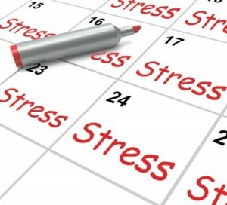
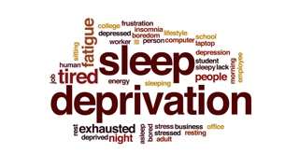
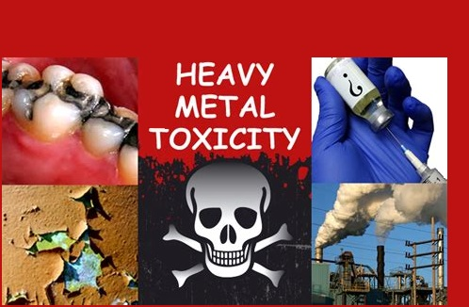
Piecing The Puzzle of Your Health Together
“You can lead a man to knowledge, but you can’t make him think”

Slide 3
Use magnifying glass below to see details of this slide

Slide 4
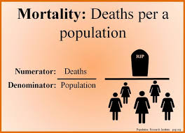
Causes of Death
World Population: 8,060,005,800
Health of the World as of 9/2023:
Deaths caused by Abortions: 31,043,440
* Cardiovascular Diseases (CVDs): 17.9 million
Deaths caused by Communicable Disease: 9,023,751
Deaths caused by Covid-19: 6,914,414
Deaths caused by Cancer: 5,709,054
Deaths caused by Smoking: 3,474,946
Deaths caused by Alcohol: 1,738,564
Deaths caused by HIV/AIDS: 1,168,550
Road traffic accident fatalities: 938,347
Deaths caused by Suicides: 745,411
Deaths caused by Seasonal Flu: 350,504
Data from website: Worldometers.info

Slide 5
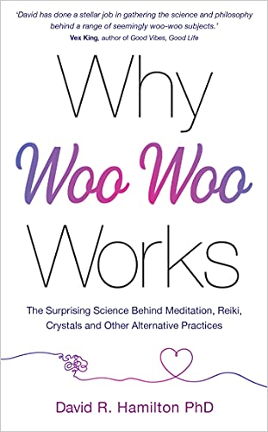
Woo Woo Stuff
David R. Hamilton, PhD
  Why Woo-Woo Works: The Surprising Science Behind Meditation, Reiki, Crystals, and Other Alternative Practices
Discover:
The science behind some of today's most popular alternative practices
How your thoughts, emotions, and beliefs have healing power
The benefits of nature and a holistic approach to healing
A fascinating link between consciousness and human connection
The relationship between suppressed emotions and disease
Woo Woo Stuff:
Mind Over Matter
Meditation
Trapped and Released Emotion
Natural healing (empathy can heal)
Reiki
Crystals (color)
Perception Shapes Your Reality
Consciousness
Telepathy, Distant Healing, and Prayer
The Right Conditions
The Law of Attraction
Classify Therapies into Five Groups:
Biologically based (herbs, supplements and diet)
Manipulative and body-based systems (massage, chiropractic)
Mind-body medicine (meditation, yoga and tai chi)
Alternative medical systems (Chinese medicine, Ayurvedic medicine and homeopathy)
Energy therapies (reiki, therapeutic touch)
“It's time to embrace the truth: That woo-woo really does work.”

Slide 6
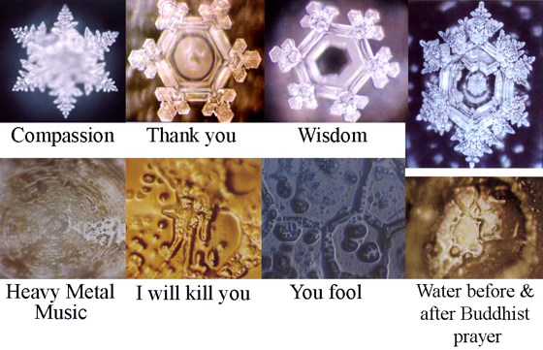
The Power of the Word
(Thoughts, Words & Deeds)
Water:
Masaru Emoto
  Messages from Water
  The Healing Power of Water
Veda Austin
  The Secret Intelligence of Water: Macroscopic Evidence of Water Responding to Human Consciousness
Law of Attraction:
Rhonda Byrne
  The Secret
Esther and Jerry Hicks
  The Law of Attraction
Mike Murphy
  The Creation Frequency: Tune In to the Power of the Universe to Manifest the Life of Your Dreams
Positive Affirmations:
Jack Canfield
  Chicken Soup for the Soul (Series)
The Power of Energy and Words:
“Sticks and stones will break my bones, but words will never hurt me.” I remember saying that phrase as a young child, hoping that there was magic in those words to take away the hurt that I was feeling. Why do negative words hurt? Because words are energy in motion.
Notes:
This book will transform your world view. Dr. Masaru Emoto’s first book, The Hidden Message in Water, talked about his discovery that crystals formed in frozen water revealed changes when specific, concentrated thoughts were directed toward them. He also found that water from clear springs and water that has been exposed to loving words showed brilliant, complex and colorful snowflake patters. In contrast, polluted water, or water exposed to negative though formed incomplete, asymmetrical patterns with dull colors.
The Thought manifests as the word; The Word manifests as the Deed; The Deed develops into habit; and the habit hardens into character.

Slide 7
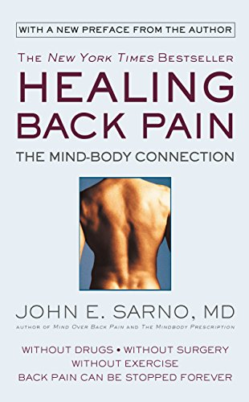
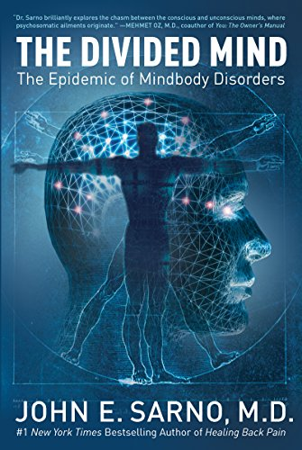
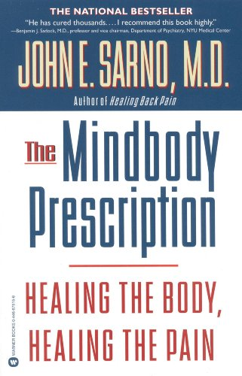
TMS
(Tension Myositis Syndrome)
Dr. John E. Sarno
Healing Back Pain: The Mind-Body Connection
The Divided Mind
  The pain is due to TMS, not to a structural abnormality
  The direct reason for the pain is mild oxygen deprivation
  TMS is a harmless condition caused by my repressed emotions
  The principal emotion is my repressed ANGER
  TMS exists only to distract my attentions from the emotions
  Since my back is basically normal there is nothing to fear
  Therefore, physical activity is not dangerous
  And I MUST resume all normal physical activity
  I will not be concerned or intimidated by the pain
  I will shift my attention from pain to the emotional issues
  I intend to be in control-NOT my subconscious mind
  I must think Psychological at all times, NOT physical.
The Mindbody Prescription: Healing the Body, Healing the Pain

Slide 8
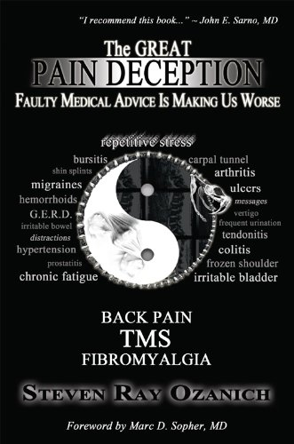
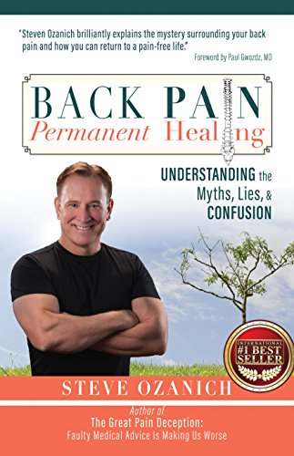
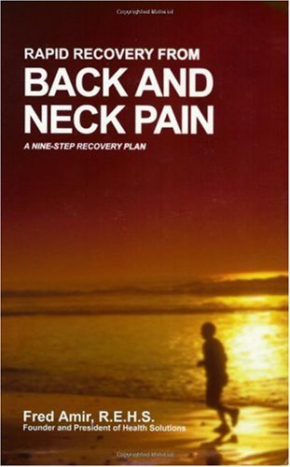
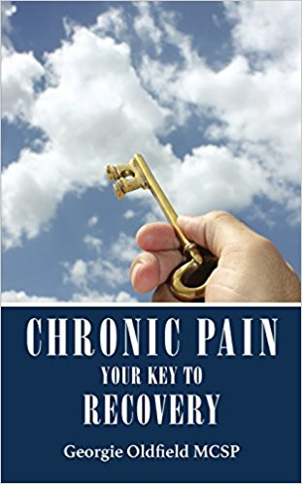
TMS
(Tension Myositis Syndrome)
Alan Gordon
  Tension Myositis Syndrome (TMS)
  Psychophysiological Disorders (PPD)
  The Mindbody Syndrome
    http://tmswiki.org
Steven Ray Ozanich
  The Great Pain Deception
  Back Pain Permanent Healing: Understanding the Myths, Lies, & Confusion
Fred Amir
  Rapid Recovery From Back and Neck Pain
Georgie Oldfield
  Chronic Pain: Your Key To Recovery

Slide 9


NPD
(Neurophysiologic Disorder)
David Hanscom, MD
Back In Control
    Stage 1—Laying the Foundation
      Expressive Writing Exercises
      Active Meditation Exercises
      Good Night’s Sleep
      Understand the neurophysiologic nature of chronic pain
    Stage 2—Forgiveness and Play
      Understand the impact of anger on your life
      Acknowledge your disguises
      Admit your victimhood
      Choose not to be a victim
      Forgive
      Play
    Stage 3—Moving Forward
      Create a vision for your life
      Address family issues and create a safe haven-family
      Get organized
      Commit to daily practice
      Think about the life you desire and connect with it
    Stage 4—Expanding Your Consciousness
      Step into your new life with or without pain
      Embark on your inward journey
      Fail well
      Go on a spiritual journey
      Give back

Slide 10
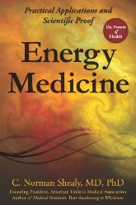
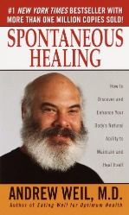

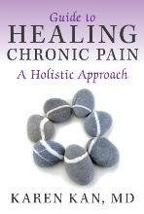
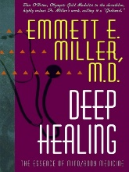
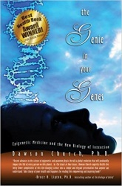
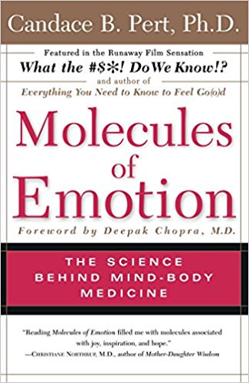
Healing
(Mind/Body/Spirit)
C. Norman Shealy, MD
  Energy Medicine
Andrew Weil, MD
  Spontaneous Healing
Amy Scher
  How to Heal Yourself When No One Else Can
Dr. Karen Kan
  Guide To Healing Chronic Pain – A Holistic Approach
Emmett E. Miller, MD
  Deep Healing: The Essence of Mind/Body Medicine
Dawson Church, PhD
  The Genie in Your Genes
Candace Pert, PhD
  Molecules of Emotion: The Science Behind Mind-Body Medicine

Slide 11
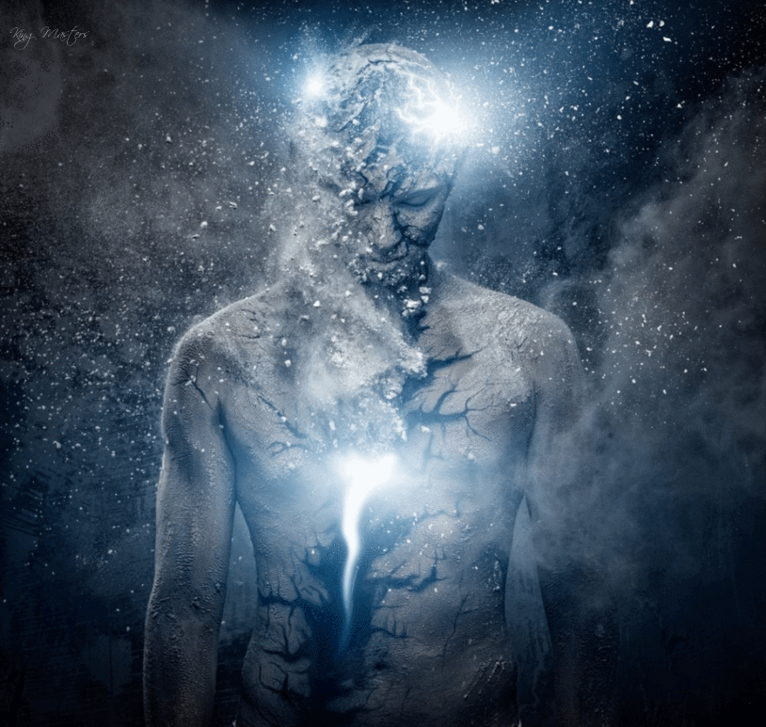
The Energy Field
(Definition)
Energy
  Power derived from the utilization of physical or chemical resources, especially to provide light and heat or to work machines.
  The first law of thermodynamics, also known as Law of Conservation of Energy, states that energy can neither be created nor destroyed; energy can only be transformed or changed from one form to another.
Healing
  The process of making or becoming sound or healthy again.
Energy Healing
  Healing that manipulates, restores or balances the flow of energy in the body. The energy is channeled through the practitioner to the client, helping remove energy deficiencies and blockages, which then activates the body's own natural ability to heal itself.
“If you want to find the secrets of the universe, think in terms of energy, frequency, and vibration”
—Nikola Tesla

Slide 12
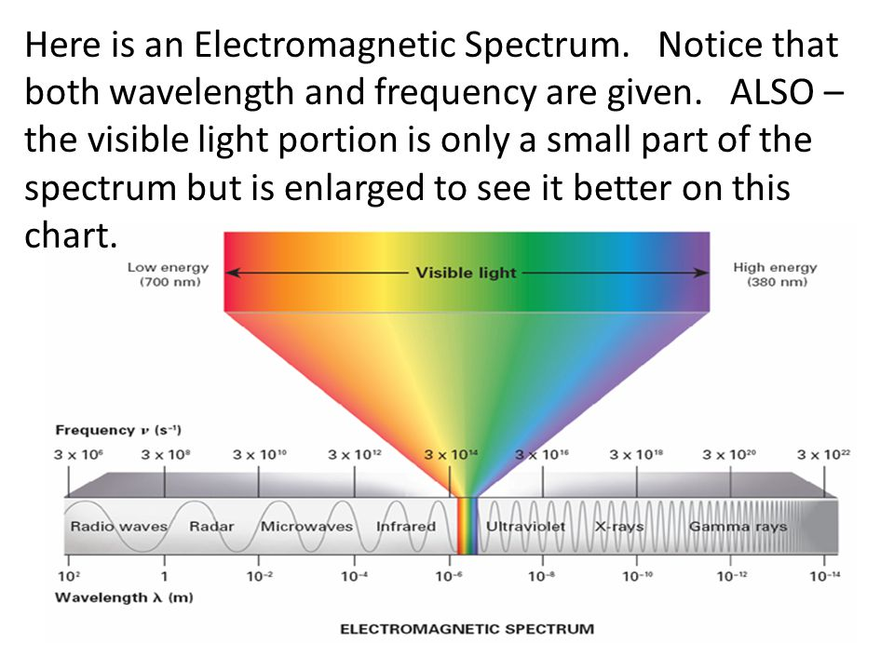
Electromagnetic Spectrum

Slide 13
Energy Modalities:
Subtle Energy:
Access Consciousness/ BARS
Acupressure
Alexander Technique
Angel Reading
Aura Healing & Aura Reading
Barbara Brennan Healing Science
Bio-photon Therapy
Breathwork
Bodytalk
Clairvoyant Reader
Color Therapy
Craniosacral Therapy
Crystal Healing
Direct Divine Light Healing™
Eden Energy Medicine
EFT (Emotional Freedom Techniques)
Energetic Healing (EH)
Energy Balancing
Energy Field Work
Energy Tapping
Esoteric Healing
Jin Shin Jyutsu
Healing Touch
Healing Touch Spiritual Ministry
Integrated Energy Therapy® (IET)
LifeLine Technique
Life Alignment
Lionheart Institute's Energy Healing
Magnified Healing
Matrix Energetics
Pendulum Healing
Pranic Healing
Polarity Therapy
Psych-K
Quantum Touch
Reconnective Healing
Reiki
RIM Method
Rising Star Healing
RoHun Therapy
Rosen Method
Shamballa Multi-Dimensional Healing
Shamanic Healing
Somatic Experiencing
Tapas Acupressure Technique (TAT)
Theta Healing
The Body Code
The Emotion Code
The Healing Code
TFT (Thought Field Therapy)
Therapeutic Touch
Touch For Health
Zero Balancing
Verbal Modalities:
ARTbundance
Creativity Coaching
Energy Psychology
Family Constellation Work
Guided Imagery/ Guided Meditation
HeartMath
Health Coaching
Hypnosis
Laughter Leader/ Laughter Yoga
Life Coaching
Neuro-linguistic Program (NLP)
Quantum Healing Hypnosis Therapy
Percussive Suggestion Technique (PSTEC)
Spiritual Counselling
Bodywork:
Massage Therapy
Reflexology
Amma Therapy
Bowen Technique
Hawaiian Bodywork
Kripalu Bodywork
Movement:
Feldenkrais Method
Qigong
T’ai Chi
Yoga
Subtle Energy of the Senses:
Aromatherapy
Art Therapy
Raindrop Therapy/ AromaTouch
SoulCollage®
Sound Healing
Therapeutic Musicians
Assessment:
Applied Kinesiology
Biofeedback
Iridology

Slide 14
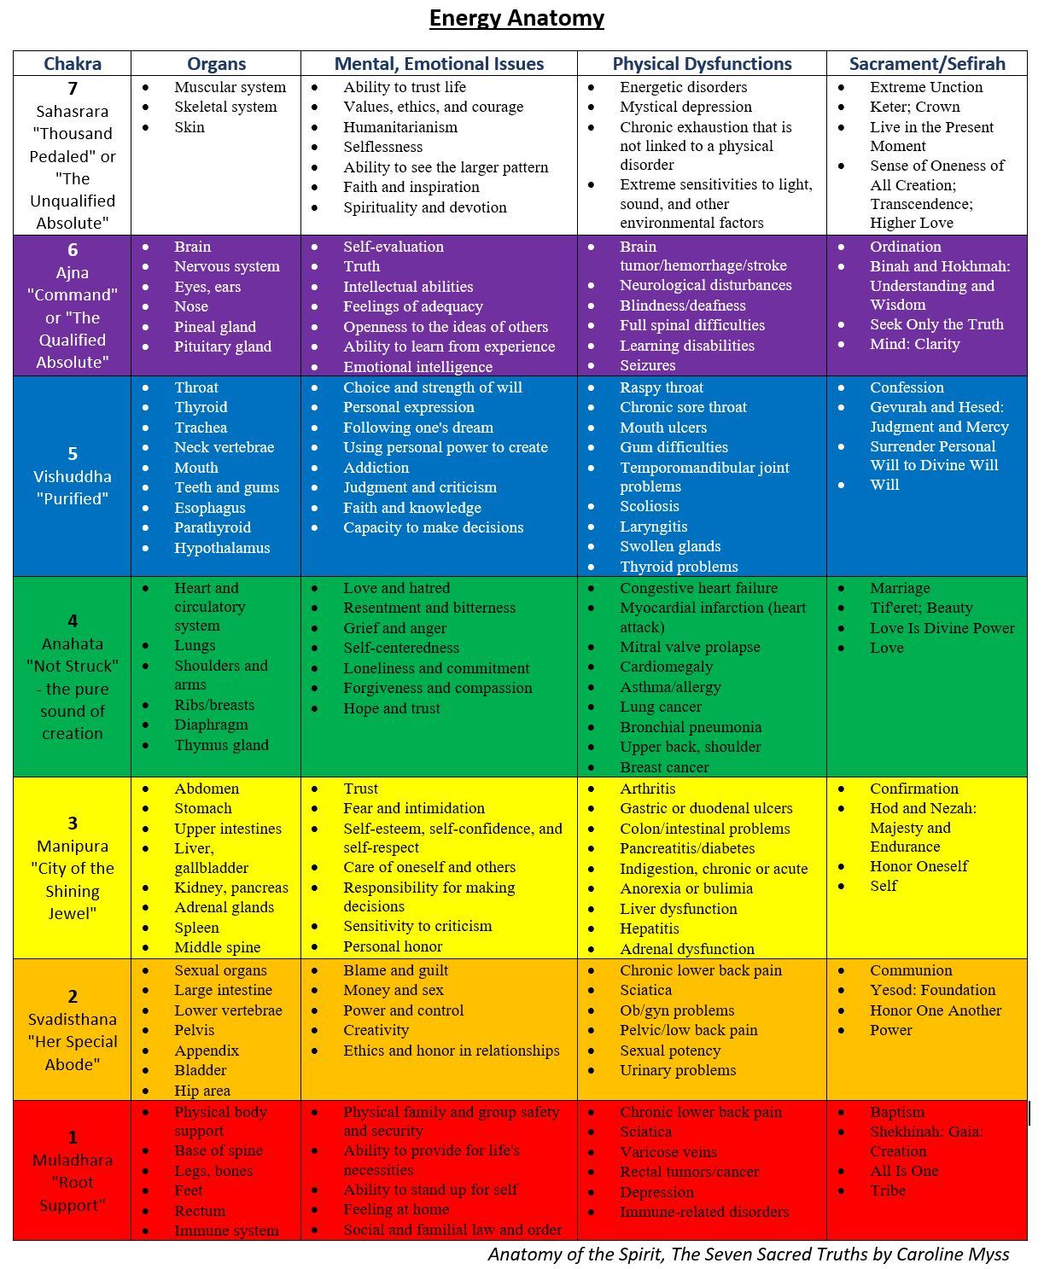
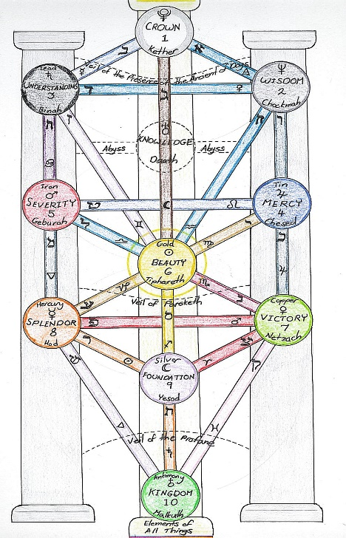
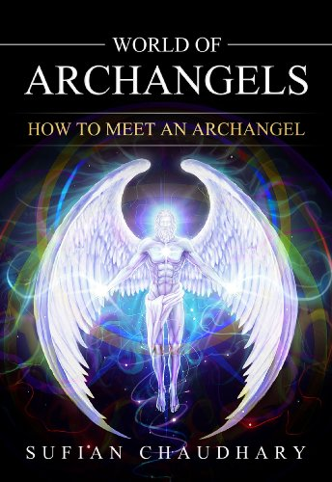
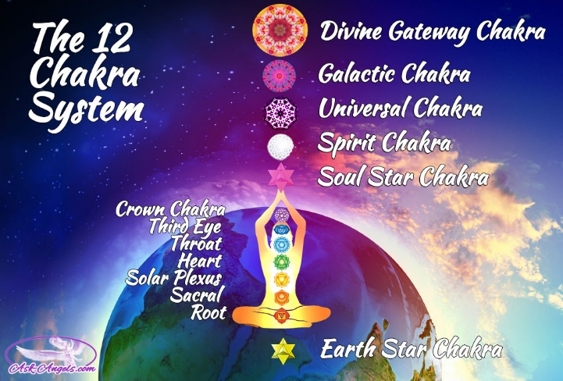
Chakras
12 Chakras that act as representatives for the 12 Dimensions that make up our Universal learning environment:
12th Chakra: Divine Gateway, Connection with the Cosmos
11th Chakra: Galactic, Advance spiritual skills, teleportation, bi-location, telekinesis
10th Chakra: Universal, Divine creativity
9th Chakra: Spirit, Soul blueprint, total skills and abilities learned in all life times
8th Chakra: Soul Star, Activates spiritual skills, energy center of Divine love
7th Chakra: Crown (Violet or Purple)
6th Chakra: Third Eye (Indigo)
5th Chakra: Throat (Blue)
4th Chakra: Heart (Green)
3rd Chakra: Solar Plexus (Yellow)
2nd Chakra: Sacral (Orange)
1st Chakra: Root (Red)
Earth Star (mother earth or Gaia)

Slide 15
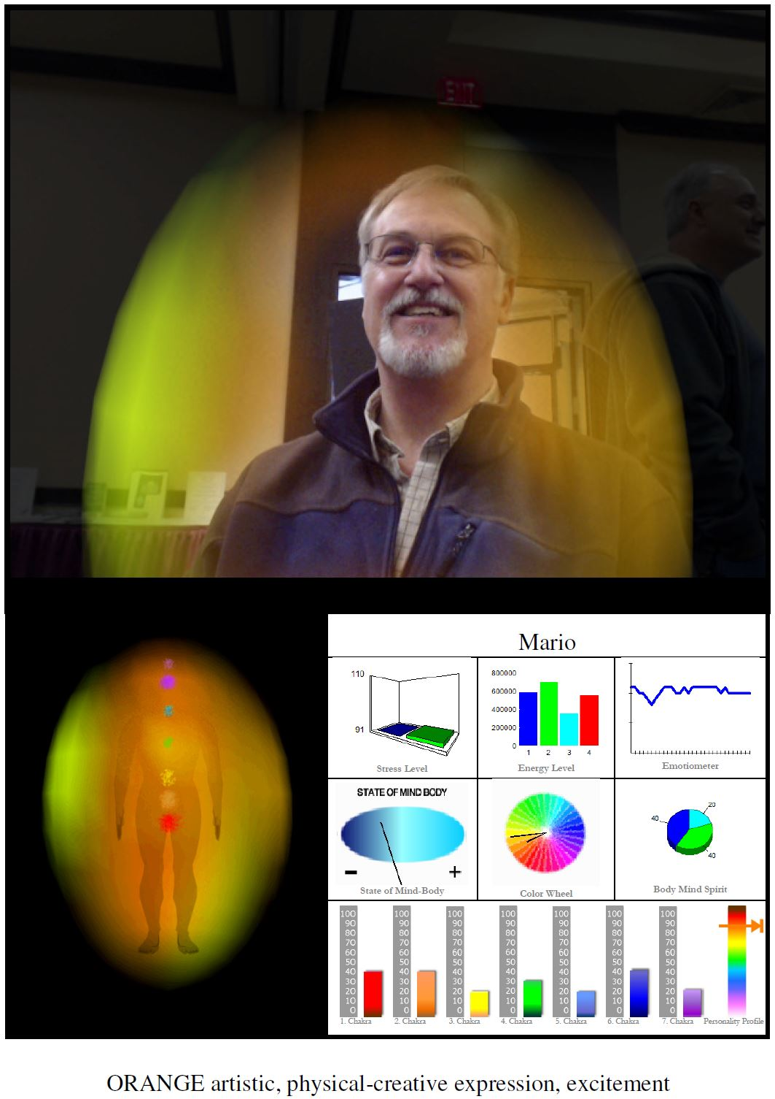
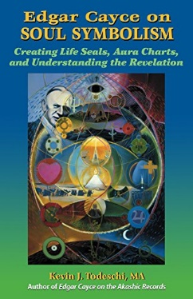

Aura
Human Energy Field
The Four Layers of the Energy Field:
  Physical (Etheric Body)
  Emotional
  Mental
  Spiritual
Kevin Todeschi
  Edgar Cayce on Soul Symbolism
William Walker Atkinson
  The Human Aura Astral Colors and Thought Forms

Slide 16
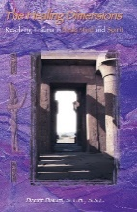
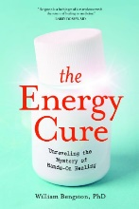
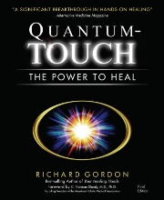
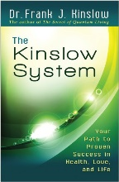
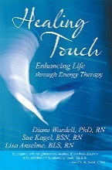
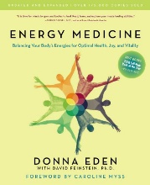
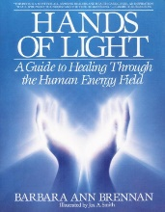
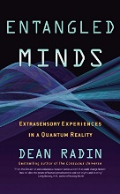
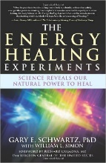
Healing Energies
Brent M. Baum (Holographic Memory Resolution)
  The Healing Dimensions: Resolving Trauma in the Body, Mind and Spirit
William Bengston
  The Energy Cure: Unraveling the Mystery of Hands-On Healing
Richard Gordon
  Quantum Touch: The Power To Heal
Dr. Frank J. Kinslow
  The Kinslow System
Diane Wardell (Healing Beyond Borders)
  Healing Touch: Enhancing Life through Energy Therapy
Donna Eden
  Energy Medicine: Balancing Your Body’s Energies for Optimal Health, Joy, and Vitality
Barbara Ann Brennan (School of Healing)
  Hands of Light: A Guide to Healing Through the Human Energy Field
Dean Radin
  Entangled Minds
Gary E. Schwartz
  The Energy Healing Experiments

Slide 17
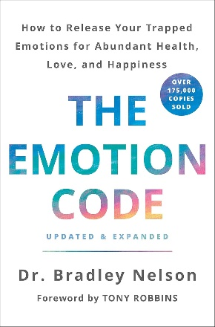
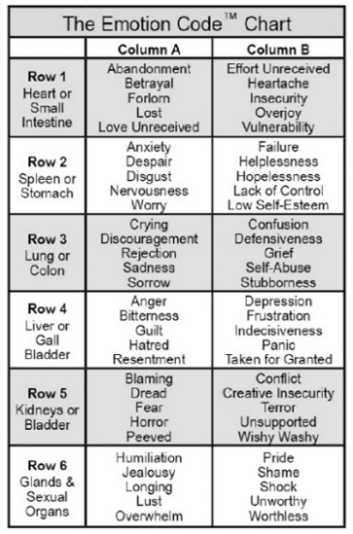
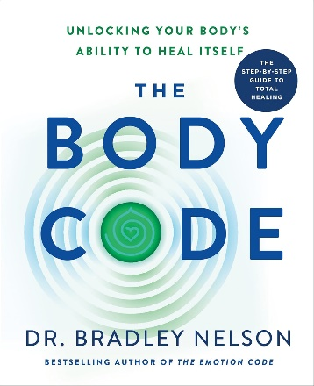
The Emotion Code/The Body Code
Dr. Bradley Nelson: How to Release Your Trapped Emotions for Abundant Health, Love, and Happiness
  The Emotion Code
    Trapped emotions can create pain, emotional stress and eventually disease
    Using kinesiology, or muscle testing to connect to the subconscious mind to find out where the emotional blockages reside
    Quickly and easily rid yourself of damaging emotional baggage and “trapped emotions”
    Finding and tearing down “Heart-wall”, unlocks improved health, relationships and abundance
  The Body Code: Unlocking Your Body's Ability to Heal Itself
    Using kinesiology or Muscle Testing
    Six Imbalances that lead to all Disease
      Energies
      Circuits & Systems
      Toxins
      Pathogens
      Misalignments
      Nutrition & Lifestyle

Slide 18
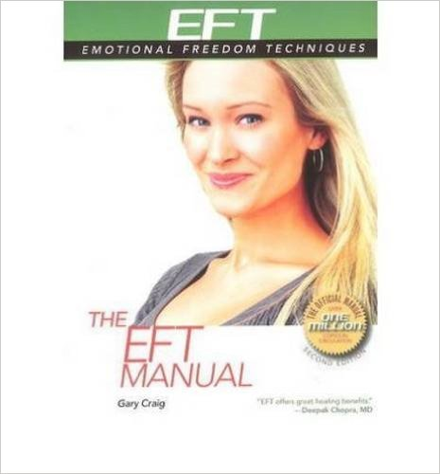
Emotional Freedom Techniques
Gary Craig (https://www.emofree.com)
  The Setup (repeat 3 times)
    Even though I have this _____(problem) I deeply & completely accept myself
    While continuously tapping the “Karate Chop” point
  The Sequence (Tap about 5 times)
    Eye Brow
    Side of Eye
    Under the Eye
    Under Nose
    Chin
    Collar Bone
    Under the Arm
    Thumb
    Index Finger
    Middle Finger
    Little Finger
    Karate Chop
  The 9-Gamut: Perform 9 Actions while tapping the GAMUT POINT continuously
    Eyes Closed
    Eyes Open
    Eyes hard down right
    Eyes hard down left
    Roll eyes in a circle
    Roll eyes in opposite direction
    Hum 5 seconds of song
    Count from 1 to 5
    Hum 5 seconds of song again
  Repeat The Sequence

Slide 19
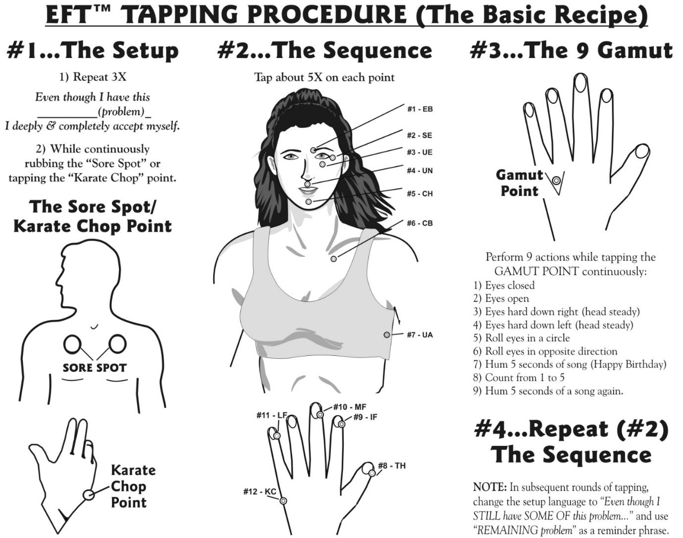
EFT
(Tapping)

Slide 20



EMDR Therapy
Eye Movement Desensitization and Reprocessing (EMDR)
Bilateral Stimulation (BLS)
  The eight phases of EMDR
  Taking the client’s history
  Preparing the client
  Assessing the target memory
  Desensitization
  Installing the positive cognition
  Body scan
  Closure
  Re-evaluation

Slide 21

The Healing Code
Alexander Loyd
  The Four Healing Centers
    Bridge
    Adams Apple
    Jaws
    Temples
  “I pray that You would find, open, and heal all negative images, beliefs, and cellular memories, and all resulting physical issues, related to ______. Replace all these unhealthy things with the love, life and light of God, and restore everything in mind, body, soul and spirit to Your original design. I also pray that you would maximize the effectiveness of this healing for my highest good, at an optimal pace.”
Notes:
Here’s the sequence:
Do the code in a quiet, private, place where you can relax without distractions or Interruptions. Have a pen and paper to write on if possible.
1. Deliberately choose an issue to work on. Write down a brief description.
E.g. ‘The painful conversation I had with my sister yesterday’.
2. Rate the issue in terms of how much it bothers you on a scale of 0-10, 10 being most painful. Write the rating down.
3. Identify the feelings and/or unhealthy beliefs related to your issue. E.g. Feeling - Anger/regret. E.g. Belief – ‘I am really stupid for getting into that argument, I am stupid’.
4. Memory Finder: Ask yourself if there was another time in your life when you felt the same or a similar way, even if the circumstances were very different.
We’re looking for the same kind of feeling. Don’t do a lot of digging. E.g. Ask when did I have these feelings before? What age was I? Go for the earliest memory that surfaces, and focus on healing that first.
What bothers us now tends to be troublesome precisely because it’s attached to or triggered by an unhealed memory. Often when you heal the earlier or strongest memory, all other memories “attached “to that core memory heal at the same time.
5. Rate that earlier memory on a scale of 0-10. If 0 is no distress or pain and 10 is maximally distressing or painful.
6. Say the prayer asking for help for your healing. Inserting whatever issues you uncovered (“my memory as a four-year-old, or if you didn’t’ uncover a memory just what is bothering you now ‘Feeling guilty about the argument’ “my headache” or whatever.)
“I pray that all known and unknown negative images, unhealthy beliefs, destructive cellular memories, and all physical issues related to ________(your problem or issue) would be found, opened and healed by filling me with the light, life and love of the Holy Spirit ( put whatever words for ‘Higher Power’ you have – The Universe, Great Spirit etc).
I also pray that the effectiveness of this healing be increased by 100 times or more.”(This tells the body to make the healing a priority.)
7. Do the Healing Code holding each position for around 30 seconds.
When you do a Healing Code, you don’t focus on the negative, but the positive. (Unlike EFT). Hold in mind something positive, that inspires you. It could be a prayer, a person, and a place – whatever works for you.
Make sure you rotate through all four positions before quitting (usually several sequences). Do the Code sequence for at least 6 minutes. You can always do longer, especially if you rated your issue above a 5 or 6. We suggest 6 minutes as the minimum.
8. After doing the Code, rate your issue again. Write your result down. It is useful to keep track of your progress in a journal. You can be pleasantly surprised just how much progress you can make in a few months of consistent practice.
The more time you spend doing the Healing Codes the faster you will get results.

Slide 22


Integrated Energy Therapy (IET®)
Stevan J. Thayer
  IET is the next level to heal with the energy of angels
  IET uses a divine angelic energy ray to work directly with your 12-Strand Spiritual DNA
  IET supports you in safely and gently releasing limiting energy patterns from your past, empowering and balancing your life in the present, and helps you to reach for the stars as you evolve into your future – getting the issues out of the tissues
  Attunements in Basic, Intermediate, Advance, and Master-Instructor
  Steps To Transformation (14 steps)
  Healing Angels of the Energy Field
  Demonstration:
    Heartlink with our Angel
    5-minute Empowerment Session
Notes:
Detailed outline of our topic:
Greetings: thank the group for inviting us. (Ruth)Have them each take an angel card.
Mario: please find a seat. I want to thank the A.R.E. for inviting us.
Ruth have people pick an angel card from the deck.
Introduction: short biography about ourselves focusing on our IET qualifications.
Mario:
Overview: (Mario) short overview of what we are going to do in the talk.
What is IET?
We are going to do a Heartlink with our Angel
Show the IET cellular map
Demonstrate a 5-minute empowerment session
Overview of a Full IET session
Classes we offer in IET…(healing angels of the energy field, Basic, Intermediate, Advanced, Steps to Transformation, IET for Kids and for Pets)...We are teaching IET here at the A.R.E….Basic level on 1 Nov, and Intermediate level on 22 Nov. See our website (on back of angel card)
What is IET?
(Ruth) see Basic book page 2 … (*include actual story about Reverie)… help you gently and safely release limiting energy patterns from your past, balance and empower you in the Present and embody your full potential as you move into your future. Release issues from the tissues and remove trauma without drama.
(Mario)…Lead in about Angels…Intro to Steve Thayer’s book (interview with an angel), angel Ariel came to him on night and he started to write this stuff down on his bedroom wall.
Heartlinks: overview of heartlinks, angels, angelic energy and our experience with it, then teach them how to heartlink to their angels (from angel card they picked).
Ruth (see attachment page 3 of Basic Level)
Sharing: (Ruth) after the process is over, have them turn to the person next to them and share what they experienced. Anyone want to share with the group?
IET: talk about IET as a means to focus the heartlink energy. Give an overview of the cellular memory map and an overview of the IET integration power points, help them understand what they are and how they are used in an IET session.
Mario: talk about the integration points from the chart
Demonstration: have a volunteer come up and sit in a chair. Do a 5-minute empowerment session on the volunteer letting the audience watch as we systematically touch the integration Power Points and clear cellular memory.
Mario: I will demo on a volunteer…talk/read last two para. on page 2.
Ruth: will explain each point
Sharing: when done, have the volunteer share what he/she experienced.
Have the volunteer share their experience
Overview of an IET session: talk to them about what a full IET session is like.
Mario: explain that a full session will be about 45 minutes to an hour. They fill out an intake form, than lay on the massage table, fully clothed (we have a heated blanket on our table as well as another top blanket, if they prefer), soft music or not, and just relax…don’t feel like you have to pray or heartlink or mudras….just relax and let the angels do the work
Class we offer in IET:
(Mario) healing angels of the energy field, Basic, Intermediate, Advanced, Steps to Transformation, IET for Kids and for Pets
(Ruth) include story about German Shepard
Final questions: Q&A and hand out our brochures and flyers about the upcoming classes and getting names for our mailing list.

Slide 23

Reconnective Healing
Dr. Eric Pearl
  Hands off the body
  Intention vs Attention
  The Book of Knowledge: The Keys of Enoch, by J. J. Hurtak
  Reconnective Healing:
    Reconnect to the universal intelligence of energy, light and information
    Return to an optimal state of balance
    The universe has expanded into new healing frequencies, reconnecting people to their original fullness as human beings
    It reconnects us to the fullness of who we are, and allows for healings that are not just physical, mental, or emotional, but go beyond that to bring us healing that includes the evolution of our very being and essence
    Your interaction with these frequencies is initiated during your session with a practitioner and continues to work with you long after
  The Reconnection (Axiatonal Lines):
    Ley lines of our planet
    Meridian Lines of the human body
    The Universal Energy Grid

Slide 24

Silva Method
Jose Silva
Close your eyes and roll them slightly upward toward your eyebrows. Turning your eyes upward about twenty degrees triggers alpha rhythms in the brain and also causes right-brain activity.
Count slowly and silently from 100 to 1. Wait about one second between numbers.
  Starting with your scalp, focus your conscious awareness on the different parts of your body from head to toe, relaxing them as you go.
When you reach the count of 1, hold a picture of yourself in your mind as youthful, radiant, healthy, and attractive.
  Ask yourself mentally, “Why do I have this physical problem?” Then let your mind wander.
  When you find yourself thinking about a certain person, picture that person.
  Picture yourself forgiving each other. Imagine a hug or a handshake, smiles, and heads nodding in agreement. Feel good about this.
Repeat mentally, “I will always maintain a perfectly healthy body and mind.”
Say to yourself, “I am going to count from 1 to 5; when I reach the count of 5, I will open my eyes, feeling fine and in perfect health, feeling better than before.”
Count. When you reach 3, repeat, “When I reach the count of 5, I will open my eyes, feeling fine and in perfect health, feeling better than before.”
At the count of 5, open your eyes and affirm mentally, “I am wide awake, feeling fine and in perfect health, feeling better than before. And this is so.”

Slide 25

Quantum Field Healing (QFH)
David R. Hamilton, PhD
Visualize the diseased area in your body.
Go inside and see the cell.
Go inside and see the DNA.
Go inside and see the atoms.
Go inside and see the subatomic particles
Go to the source and imagine yourself at the quantum field—a place of total stillness.
Say, “Show me the waves/vibrations of [name of disease/pain],” and imagine them in any way you fell represents the reality of the condition.
Affirm, “Cancel!” and watch the waves collapse and disappear.
Say, “Show me the waves of [perfect health, healing] and imagine pebbles of brilliant light (any color)
Come back out to the subatomic particles and say, “Show me that it is done.” See them take the colors that you chose (shimmering sky like the northern lights).
Come back out to the atoms and say, “Show me that it is done.” Again, see a change in color.
Come back out to the DNA and say, “Show me that it is done.” See a change.
Come back out to the cells and say, “Show me that it is done.” See a change.
Come back out to the body area and say, “Show me that it is done.” See a change.
Watch a healing scene if you wish.
Come back out to the whole body and say, “ Show me that it is done.” See the body enveloped by your chosen colors.
Say, “Thank you, It is done. It is done. It is done.”

Slide 26

Theta Healing
Vianna Stibal
  Center and ground yourself
  Go up above yourself through your crown
  Go to the Seventh Plane of Existence
  Connect to the Creator of All That Is
  Make the command
  Say, “Thank you”
  Say, “It is done, It is done. It is done.”
  Witness with the Creator
  Rinse yourself off, ground yourself and make an energy break
Belief Work Principles:
  Core Belief Level (taught and accepted from childhood)
  Genetic Level (ancestral/Physical DNA)
  Historical Level (memories from past lives or collective consciousness experiences)
  Soul Level (all that a person is)
Notes:
Beta Frequency; Waking Consciousness and Reasoning Wave (14-40 Hz) 12-27 Hz
Alpha Frequency; Deep Relaxation Wave (7.5-14 Hz)
Theta Frequency; Light Meditation and Sleeping Wave (4-7.5 Hz)
Delta Frequency; Deep Sleep Wave (.05-4 Hz)
Gamm Frequency; Inspiration Higher Learning Focus (above 40 Hz)
The seventh Plane of existence
This is the plane of the Creator of All That Is, the energy that flows through all things to create life. Here we have the realization that we are part of All That Is, part of God. On the Seventh Plane, we can utilize the energies of all the planes without being bound by any oaths and commitments to them. This is because the energy of the Seventh Plane creates the other planes. It is the energy that makes the quarks that make the protons, neutrons and electrons that in turn make up the nucleus of an atom.
The sixth Plane of existence
This is the plane of the Laws that create the very fabric of the universe, such as the Law of Time, the Law of Magnetism, the Law of Gravity, the Law of Light, and many more.
The fifth Plane of existence
This is the plane of the divine and semi-divine beings, the plane of the masters, such as Jesus Christ and the Buddha. It is divided into different levels of vibration and consciousness. The lower levels are the ultimate in dualism. Everyone on this planet is some kind of Fifth-Plane being.
The fourth Plane of existence
This plane is the realm of spirit – what some people would call the ‘spirit world.’ It is where spirits exist after death, where our ancestors are in waiting. It is the school of the Fifth-Plane beings – the spirits of this place are still learning and have not graduated to higher vibrations of reality.
The third Plane of existence
This is the plane of protein-based life-forms such as humans and other animals. In part, we have created it so that we can experience the challenge of being governed by emotions and instinctual desires, and the reality of being in a human body in a physical world. Here we learn how to graduate past the Fourth Plane and go forward to the Fifth Plane.
The second Plane of existence
This plane consists of organic material: vitamins, plants, and trees. Fairies are attracted to it because of the trees and plants.
The first Plane of existence
This plane consists of all the inorganic material on this Earth: the minerals, crystals, soil, and rocks, all the elements that make up the Earth in its raw form, all the atoms in the periodic table before they bind to carbon bases (and so become organic).

Slide 27





Pendulum/Dowsing Healing
(Pendulums, L-Rods, Y-Rods, and Bobbers)
Erich Hunter, PhD
https://www.erichhunter.com
  Pendulum Healing
  Pendulum Master
  Advanced Pendulum Healing
Raymon Grace
http://www.raymongrace.us
  The Future is Yours
Walt Woods
https://lettertorobin.wordpress.com
  Letter to Robin (.pdf)
  Dowsing: Programing for Personal Dowsing (.pdf)

Slide 28




Hypnosis/NLP
Michael Newton
  Life Between Lives: Hypnotherapy for Spiritual Regression
Dr. Brian Weiss (past-life regression)
  Many Lives, Many Master
Maxwell Maltz
  Psycho-Cybernetics
Calvin D. Banyan
  Hypnosis and Hypnotherapy Basic to Advanced Techniques for the Professional
Gerald Kein
  Omni Hypnosis Training Center
  Ultra-Height
  The Law of Compounding Suggestion
  Patter Scripts
David Snyder (http://www.nlppower.com)
  Neuro-Linguistic Programming
  Metaphors, create “healing stories”
  Anchoring
  Reframing
  The Gray Room
Notes:
Neuro: Our nervous system, or our mind, which we use to experience the world, through our senses:
Visual
Auditory
Kinesthetic
Olfactory
Gustatory
Linguistic: The language and other communication we use to store experience and give it meaning, including the following things we experience inside our mind:
Pictures
Sounds
Feelings
Smells
Tastes
Internal Dialog (self-talk)
Programming: Discovering and using the programs, patterns and strategies we run in our mind to achieve our goals.

Slide 29







Near-Death Experiences
(NDE)
Raymond Moody
  Life After Life
George G. Ritchie
  Return from Tomorrow
Nigel W. D. Mumford
  Dying to Live: How Near-Death Experience Transform Our Faith
Robert J. Grant
  The Place We Call Home: Exploring The Soul’s Existence After Death
Melvin Morse, Paul Perry
  Closer To The Light: Learning From the Near-Death Experiences of Children
Claudia Watts Edge
  Gifts From The Edge: Stories of the Other Side
David Bennett
  A Voice as Old as Time: Contemplations for Spiritual Transformation

Slide 30






Spiritual Healing
Neville Goddard (The Law of Imagining)
  Manifesting Miracles
  The Power of Awareness
Catherine Ponder (Unity Church)
  The Dynamic Laws of Healing
  The Dynamic Laws of Prayer
Harry Edwards (Spiritual Healer)
  A Guide to Spirit Healing
Edgar Cayce (Christian Mystic)
  A Search for God
  Meditation Prayer & Affirmations
  The Power of Your Mind
  Reincarnation & Karma
Sir Arthur Conan Doyle (Christian Spiritualism)
  The History of Spiritualism
William Walker Atkinson (New Thought)
  How To Heal Oneself and Other Mental Therapeutics

Slide 31





Spirit Possession
George Schwimmer
  Earthbound Spirits are Attached To You
Dr. Carl Wickland
  Thirty Years Among the Dead
Dr. Edith Fiore
  The Unquiet Dead
Francis MacNutt
  Deliverance from Evil Spirits

Slide 32





Belief
Bruce Lipton
  The Biology of Belief
Gregg Braden
  The Divine Matrix: Bridging Time, Space, Miracles, and Belief
  The God Code
Caroline Myss
  Anatomy of the Spirit: The Seven Stages of Power and Healing
Nigel Mumford
  The Forgotten Touch: More Stories of Healing

Slide 33

False/Limited Beliefs
(Prolific Myths – thoughts, beliefs, and attitudes)
1. It's a medical diagnosis and The Doctor said it, so it must be true.
2. More is better. ["Biphasic Dose Response" whereby doing too much can actually result in a lesser benefit than more.]
3. Real men don't cry.
4. You have to finish projects that you started.
5. No Pain, No Gain. Exercise is the path to good health.
6. You can't re-grow your cartilage.
7. Butter and eggs are bad for you.
8. Daily low dose aspirin is good for your heart.
9. You should get flu shot every year.
10. Sunlight causes skin cancer. Sun screen protects you from skin cancer.
11. Low salt diet helps keep your blood pressure down.
12. You get all the iodine you need in table salt. (What, even if you're on a low salt diet?)
13. Life owes me something.
14. The universe is out to get me.
15. I'm stuck in my current life situation.
16. It's too late to start anything. It's too late to pursue my dreams.
17. Others will think what I'm doing is foolish.
18. I can't be my real self or I'll be judged.
19. I can't pursue my dreams because I might fail.
20. You'll never be successful because you didn't finish college.
21. "Four out of five physicians"... preferred Camel cigarettes.
22. Margarine is a healthier fat option than natural butter.
23. Eating fat makes you fat.
24. Vaccination is the only way to build robust immunity to infectious disease.
25. Drinking fluoridated water helps prevent tooth decay.
26. Chronic pain is a normal part of aging process.
27. FDA-approved pharmaceuticals are the only means by which disease can be cured.
28. Chemotherapy, radiation and surgery are the only effective methods of treating cancer.
29. Impossible for a human being to run a mile in less than 4 minutes. (Roger Bannister, 1954, 3 minutes 59.4 seconds)
30. I'm not good enough (I'm not safe)
31. I'm not good enough (I am not whole, I have lost my spirit)
32. I'm not good enough (I don't belong)
33. I'm not good enough (I have no value, I'm worthless)
34. I'm not good enough (I'm powerless)
35. I’m not good enough (I am wrong, I am unsure)
36. I'm not good enough (My life is out of balance)
37. I'm not good enough (I don’t exist; I am nothing)
38. I’m not good enough (I am not real)
39. I'm not good enough (I am unlovable; unwanted)
40. I'm not good enough (I am defective)

Slide 34


Healthy Biological Terrain
Bryant A. Meyers
  PEMF - the Fifth Element of Health
    The 5 Elements of Health; 1 Earth/Food, 2 Water/Liquid, 3 Air/Oxygen, 4 Fire/Sunlight, 5 Earth’s natural PEMF
“The terrain is everything; the germ is nothing.”
  Glucose Level: between 80 - 100 mg/dl (<Hypoglycemia, >Diabetes)
  Blood Pressure: [120 - 140]/[80 - 90] (<Hypotension, >Hypertension)
  Temperature: 98.6 - 100 (<Hypothyroidism, >Fever)
  Oxygen Level: pa02 > 95% (<Hypoxia, >Doesn’t occur)
  pH: 7.35 - 7.45 (<Chronic Pain, >Throbbing Pain (inflammation response))
  CO2 Levels: 23-29 mEq/L (<Hypocapnia, >Hypercapnia)
“Maintaining a healthy internal terrain is your first priority,
and boosting your immune system is second”

Slide 35


Frequency Specific Microcurrent Therapy
(FSM)
Carolyn McMakin
  The Resonance Effect
Thousands of patients with conditions that did not respond to other medical therapies recovered from pain and disability through the non-invasive treatment from FSM Therapy. For example, asthma resolves with specific frequencies that remove inflammation, allergy reaction, and spasm from the bronchi. One frequency combination eliminates shingles pain in minutes and stops the shingles attack with a single three-hour treatment. Since 2005, a series of frequencies has been used to treat hundreds of PTSD patients. Post-surgical patients use FSM to reduce pain, prevent bruising, and increase healing. NFL, NHL, and Olympic athletes use it to heal injuries and improve performance.
9 Hz Allergy Reaction
294, 321, 9 Hz “Basic”: Trauma, Paralysis, Allergy
94 Hz Concussion, Nerve Trauma
50 Hz Congestion
284 Hz Chronic Inflammation
59 Hz Cystic Condition
970 Hz Emotional Component
51 Hz Fibrosis
18 Hz Hemorrhage, Leaking
61 Hz Infection “Parasite” or Virus
40 Hz Inflammation
91 Hz Hardening, “Stone,” Calcium Deposits
49 Hz Vitality—Promotes Vitality
“is not the strength of the signal that counts—it is its frequency.”

Slide 36


Sound Healing
(Toning, Frequencies and Vibrations)
Jonathan Goldman
  The 7 Secrets of Sound Healing
  Everything Is Vibration
  Intent Is Powerful
  We Are All Unique Vibratory Beings
  Silence Is Golden
  Our Voice Is the Most Healing Instrument
  There Are Many Notes in a Scale
  Sound Can Change the World
Tibetan Bowl Sound Healing
Tuning Forks
Chanting and Toning
Magnet Therapy
Grounding or Earthing (tuning into the earths frequency)
Solfeggio Frequencies
Hemispheric Synchronization (Hemi Sync)
Microcurrent Frequency: Royal Rife, Spooky2, Z-app/Z-Amplifier, Healy
PEMF (Pulsed Electromagnetic Field) Therapy: Centropix Kloud, Bemer Mat, Amethyst Jade Tourmaline Photon Mat, iMRS2000 Prime
Notes:
The proclaimed "Solfeggio frequencies" are:
UT - 396 Hz - Liberating Guilt and Fear.
RE - 417 Hz - Undoing Situations and Facilitating Change.
MI - 528 Hz - Transformation and Miracles (DNA Repair)
FA - 639 Hz - Connecting/Relationships.
SOL - 741 Hz - Awakening Intuition.
LA - 852 Hz - Returning to Spiritual Order.

Slide 37


Healing is Voltage
Jerry Tennant
  Healing is Voltage
Salivary and urinary pH are about 0.8 pH units less than cell pH.
The main thing that controls voltage are thyroid hormone, fulvic acid, dental infections, scars and exercise.
Fat is critical to the cell being able to do its work at -20mV and to repair itself at -50mV. Without an adequate amount of good fat, the cell membrane can't function and thus the cell can't function.
The minus sign means that the voltage of a cell or substance makes it an electron donor, thus it has life and energy to give out.
If the voltage of a solution drops to a positive side it becomes an electron stealer robbing sells of their life force.
Cell pH = Voltage
  0 = +400mV (Most Acidic)
  6.48 = +30mV (Cancer occurs)
  7 = 0mV (Change polarity, Neutral)
  7.18 = -10mV (Sick)
  7.26 = -15mV (Tired)
  7.35 = -20mV (Normal)
  7.45 = -25mV (Normal for adults)
  7.61 = -35mV (Normal for kids)
  7.88 = -50mV (Make new cells)
  14 = -400mV (Most Alkaline)

Slide 38


Earthing or Grounding
Clinton Ober
  Earthing: The most important health discovery ever!
Earthing restores and maintains the human body’s most natural electrical state, which in turn promotes optimum health and functionality in daily life
The primordial natural energy emanating from the Earth is the ultimate anti-inflammatory and the ultimate antiaging medicine
Walk, stand, and sit barefoot on the ground for a half hour or so; or use conductive bed sheets or floor mats linked by wire to a ground rod or plugged into a wall outlet with a modern Earth ground system
We have become disconnected from the Earth, literally, by wearing synthetic-soled shoes
The body is different when connected to the Earth, and heals much faster. Earthing = Power Healing
Benefits of Grounding:
Helps improve circulation and energy
Swollen joints and varicose veins subside
Asthma and other respiratory ailments
Headaches often become less intense and frequent
Heartburn
Reduce or eliminate bedsores
Dry skin
Speeds wound healing
Reduces inflammation
Illnesses do not come upon us out of the blue. They are developed from small daily sins against Nature. When enough sins have accumulated, illnesses will suddenly appear.
~Hippocrates

Slide 39


The Respiratory System
Nasal Cavity
Pharynx
Larynx
Trachea
Bronchi
Bronchioles
Lungs
Respiratory Diseases:
Acute Bronchitis
Allergic asthma
Asthma
Bronchiolitis
Chronic bronchitis
Emphysema
Flu
Lung cancer
Pneumonia
Pulmonary edema
Death from Chronic Lower Respiratory Disease in the US: 160,201 (5.7%)
Chronic Obstructive Pulmonary Disease (COPD) is an umbrella term used to describe progressive lung diseases including emphysema, chronic bronchitis, and refractory (non-reversible) asthma. This disease is characterized by increasing breathlessness.

Slide 40


Buteyko Breathing Normalization
Sasha Yakoleva
  Breathe to Heal: Break Free From Asthma
Breathing rate is controlled not by the amount of oxygen in the blood but by the amount of carbon dioxide (CO2), the gas that regulates the acid-base level of the blood.
A deficiency of CO2 in the lungs must be present in order for allergic inflammation of the bronchial tubes to appear or to flare up.
Conventional medicine does not know the cause of asthma…the main cause of this disease —hyperventilation — the removal of which brings about the cure for an asthmatic and provides prevention.
Hyperventilation was not only a cause of asthma but also about one hundred and fifty of the most widespread diseases.
You will only conquer asthma if you can raise your CP (Control Pause).
Buteyko Breathing Exercise:
Asthma attacks will stop when they have a morning CP (Control Pause) greater than 20 seconds.
If your morning PMP (Positive Maximum Pause) is more that 40, you will know that you are free of viral and other infections.

Slide 41





Mindfulness Meditation
Sharon Salzberg
  Real Happiness: The Power of Meditation
  Real Happiness at Work
Thich Nhat Hanh
  The Miracle of Mindfulness
Jon Kabat-Zinn
  Mindfulness for Beginners
  Wherever You Go, There You Are
Why heartfulness is synonymous with true mindfulness
The value of coming back to our bodies and to our senses over and over again
How our thoughts “self-liberate” when touched by awareness
Moving beyond our “story” into direct experience
Stabilizing our attention and presence amidst daily activities
The three poisons that cause suffering—and their antidotes
How mindfulness heals, even after the fact
Reclaiming our wholeness, and more

Slide 42

The Digestive System
Remember, digestion starts in the mouth, chew your food well
Digestive juices: saliva, stomach acid, bile, and enzymes
Pancreas: makes digestive juice that has enzymes that break down carbohydrates, fats, and proteins
Liver: makes digestive juice called bile that helps digest fats and some vitamins
Gallbladder: stores bile between meals
Small Intestine: makes digestive juice, mixes with bile and pancreatic juice to complete the breakdown of proteins, carbohydrates, and fats. Bacteria in small intestine make some of the enzymes needed to digest carbohydrates
Large Intestine: bacteria in Large Intestine help break down remaining nutrients and make vitamin K. Waste products of digestion become stool
Nerves and Hormones help control the digestive process
“All Disease Begins in The Gut” ~Hippocrates
Leaky Gut Syndrome: a digestive condition in which bacteria and toxins are able to “leak” through the intestinal wall
Irritable Bowel Syndrome (IBS): common disorder that affects the large intestine. Signs and symptoms include cramping, abdominal pain, bloating, gas, and diarrhea or constipation, or both
Inflammatory Bowel Diseases (IBD) or Crohn’s Disease: a chronic inflammatory condition of the gastrointestinal tract.

Slide 43






Obesity Epidemic
(Sugar and High-Fructose Corn Syrup)
John Yudkin
  Pure, White, and Deadly: How Sugar Is Killing Us and What We Can Do to Stop It
Robert Lustig, MD
  Fat Chance: Beating the Odds Against SUGAR, PROCESSED FOOD, OBESITY, and DISEASE
There is no physiological requirement for sugar; all human nutritional needs can be met in full without having to take a single spoon of white or brown or raw sugar, on its own or in any food or drink.
If only a small fraction of what is already known about the effects of sugar were to be revealed in relation to any other material used as a food additive, that material would promptly be banned.
Sucrose, is made up of one unit of glucose joined to one unit of fructose. It is the fructose part of sucrose that is responsible for many of the undesirable effects of sucrose in the body.
Coronary heart disease continues to increase on a world-wide scale in rough proportion to the increase of sucrose consumption but not in proportion with saturated-fat intake
Robert Lustig is at the forefront of war against sugar — showing us that it's toxic, it's addictive, and it's everywhere because the food companies want it to be.

Slide 44


How Credible is YOUR Doctor?
Ken D. Berry, MD
Lies My Doctor Told Me (Second Edition): Medical Myths That Can Harm Your Health
Malcolm Kendrick, MD
Doctoring Data: How to sort out medical advice from medical nonsense
“…the food industry for 100 years and is based around improving profit, palatability, shelf-life, transportability, and, lastly, health.”
THE LIE: eating fat, especially saturated fat, leads to high cholesterol, obesity, and heart disease.
THE LIE: drinking milk is good for you and helps keep your bones strong.
THE LIE: high cholesterol levels in your blood are dangerous and increase your risk of hear attack. You should eat less saturated fat and take cholesterol medicine if your cholesterol level is above normal.
Association does not mean causation
Absolute Risk vs. Relative Risk
The absolute difference in deaths is 1 person per 100 vs. 2 people per 100 = 1 in 100, or 1%.
The relative difference in deaths is 1 vs. 2 ( ½ = 50%).

Slide 45



How Credible is YOUR Doctor?
Kevin Reese, Dr.
Medical Monopoly: The Evil Empire You’ve Been Tricked To Trust
Peace Over Pain: How To Eliminate Chronic Pain and or Chronic Illness So You Can Break-Free From the Medical Monopoly
Acute vs Chronic:
Acute conditions are short, sharp and urgent events like heart attacks, strokes, broken bones, wounds, infections, etc...typically call 911 or go immediately to the emergency department
Chronic conditions on the other hand are uncomfortable nagging long-lasting symptoms that disrupt your quality of life such as migraines, arthritis, osteoporosis, fibromyalgia, knee pain, back pain, etc...typically go see primary care physician, more than likely send you to a specialist (three options; drugs, injections or surgeries)
Primary Care Physician:
They are trained to point you in is that of drugs. The four main drugs they will prescribe; proton pump inhibitors (PPIs), statins, blood pressure meds and insulin (all huge revenue streams)
PPIs will alkalize your stomach and make you feel better; however, it will decrease your stomach acid even more causing acid reflux or GERD, leading to hundreds of new symptoms down the road because you need stomach acid, without it, you cannot heal from chronic conditions
Statin drugs lower your cholesterol levels; Cholesterol is actually needed to heal. Since statin drugs released in 1987, dementia cases have increased at a rate that should be considered an epidemic of the human race
Blood pressure or hypertension at the root is a result of either mineral deficiencies and/or chronic stress. Both of these root causes can easily be reversed
Insulin is technically not a drug, but a hormone replacement for those that lack it. Type 1 Diabetes will need this hormone injection for the rest of your life because this is a birth defect. However, Type 2 Diabetes is a chronic condition resulting from nutritional deficiency

Slide 46

How Credible is YOUR Doctor?
Dr. Joel D. Wallach & Dr. Ma Lan
  Dead Doctors Don’t Lie
“… the average life of doctors is just 58 years”
We Cured Diseases in Animals with Nutrition!:
Mineral deficiencies are the root cause of most diseases mistakenly thought to be “genetically transmitted.”
The reason that we put the vitamins, minerals, and trace minerals into animal feeds was because we don’t have health insurance policies for livestock
Selenium deficiency causes infertility, miscarriages, cystic fibrosis of the pancreas, Sudden Infant Death Syndrome in animals, liver cirrhosis, stiff lamb disease, white muscle disease, muscular dystrophy, anemias, encephalomalacia (Alzheimer’s disease), cardiomyopathy heart disease, and mulberry heart disease
Copper deficiency would cause aneurysms, as well as crow’s feet, skin wrinkles, spider veins, varicose veins, hemorrhoids, liver cirrhosis, iron storage disease, and iron resistant anemia
Vitamin A deficiency in children caused keratitis, corneal ulcers, and blindness
Calcium deficiency caused osteomalacia in children and arthritis and osteoporosis in adults
Iodine and copper deficiencies caused goiter in adults and miscarriages
Folic acid or zinc deficiencies can cause infants born with spina bifida and serious cleft palates
Thiamin or vitamin B1 deficiency causes beriberi with resultant congestive heart failure was common
60 Minerals:
Calcium, Magnesium, Phosphorus, Potassium, Sodium, Chloride, Sulfur, Cobalt, Copper, Aluminum, Arsenic, Barium, Beryllium, Boron, Bromine, Carbon, Iodine, Iron, Manganese, Selenium, Zinc, Cerium, Cesium, Chrome, Dysprosium, Erbium, Europium, Gadolinium, Gallium, Germanium, Gold, Hafnium, Holmium, Hydrogen, Lanthanum, Lithium, Lutetium, Molybdenum, Neodymium, Nickel, Niobium, Nitrogen, Oxygen, Praseodymium, Rhenium, Rubidium, Samarium, Scandium, Silica, Silver, Strontium, Tantalum, Terbium, Thulium, Tin, Titanium, Vanadium, Ytterbium, Yttrium, Zirconium.
16 Vitamins:
Vitamin A, Vitamin B1 (Thiamine), Vitamin B2 (Riboflavin), Vitamin B3 (Niacin), Vitamin B5 (pantothenic acid), Vitamin B6 (pyridoxine), Vitamin B12 (cobalamin), Vitamin C, Vitamin D, Vitamin E, Vitamin K, Biotin, Choline, Flavonoids and Bioflavonoids, Folic acid, Inositol.
12 Amino Acids:
Valine, Lysine, Threonine, Leucine, Isoleucine, Tryptophan, Phenylalanine, Methionine, Histidine, Arginine, Taurine, Tyrosine.
2-3 Essential Fatty Acids (EFAs):
Omega 3 (EPA, DHA, ALA), Omega 6, Omega 9
“Every Animal and every human that dies of natural causes, dies of a nutritional deficiency disease”

Slide 47


Wholistic -vs- Allopathic
Peter J Glidden, ND
Everybody Is Sick, And I Know Why
Attempt A Cure With Wholistic Medicine: Dr. Glidden's Naturopathic Treatment Notebook For The Enlightened
“Support and promote the healthy function of the human body at the cellular level.”
Recommendations for a Healthy Life:
Supplement your diet with the 90 Essential Vitamins, Minerals, and Fatty Acids
Take antioxidants equaling or exceeding 20,000 ORAC (Oxygen Radical Absorbance Capacity) points every day
Stop consuming any oil that is in a bottle-even olive oil and salad dressing, and remove the following foods from your diet immediately: Wheat, Barley, Rye, Oats, Fried food, well done meat, meat with nitrates, skins of baked potatoes, non-organic and /or GMO corn, and non-organic and/or GMO soy
Drink 1-2 quarts of pure water daily, depending on your body weight. Avoid water bottled in thin plastic. Only drink alkalinized water between meals
Eat less than you need to fill yourself up. Reduce the amount of food that you eat
These foods are beneficial and should be emphasized: Eggs, Butter, Salt, Meat, Chicken (with the skin), Fish, Vegetables, Fruit, Nuts, Rice, Beans, Milk and milk products, Millet, Quinoa, Seaweed, Red wine, Herbal teas, Spices, and Lard
Wholistic Medicine (Systems – Oriented) = NDs, DCs, Acupuncturists
Allopathic Medicine (Reductionism) = MDs practice

Slide 48

Homeopathy Medicine
Amy L. Lansky, PhD
Impossible Cure: The Promise of Homeopathy
“Support and promote the healthy function of the human body at the cellular level.”
Law of Similars:
This law states that a disease can be cured by a substance if that substance can cause, in a healthy person, symptoms similar to those of the disease.
To cure any disease with symptoms x-y-z, a homeopath must simply find a remedy that causes x-y-z in a healthy person
“Let Likes Be Cured by Likes”

Slide 49


Standard of Care
Jennifer Daniels, MD/MBA
The Lethal Dose (Murder by Medicine Is No Accident)
“People need to stop asking permission for things they already have the right to do.”
The Truth About The Pharmaceutical Drug Model:
The drug company patents a drug
The drug company determines the minimum lethal dose
The drug company sets the recommended dose a t a level that is HIGHER than the lethal dose (they write the Standard of Care)
The doctors are expected to prescribe the lethal dose so they (the hospital and the drug companies) can sell the maximum amount of the drug possible
Hospitals agree to be a place where dangerous drugs can be administered and monitored (they too can write the Standard of Care)
The hospital makes certain that insurance is in place (and insurance companies can also write the Standard of Care)
Everyone gets paid when the patient finally dies
As much as 107,000 people die every year from properly prescribed medications
LD 50 is the dose of a drug at which 50% of those who take it die, actually drop dead.
92,000 deaths every year by doctors who are incompetent, doctors who deviate from the Standard of Care
Malpractice is defined as “deviation from the Standard of Care.”

Slide 50





Nutrition
(Medical Medium)
Anthony William (Healing From Epstein-Barr Virus (EBV))
  Medical Medium: Secrets Behind Chronic and Mystery
  Illness and How to Finally Heal
  Medical Medium Life-Changing Foods
  Medical Medium Thyroid Healing
  Medical Medium Liver Rescue
Healing Herbs and Supplements:
Cat’s Claw, reduces EBV
Silver Hydrosol, lowers EBV load
Zinc, strengthens immune system, protects thyroid
Vitamin B12, strengthens central nervous system
Licorice Root, lowers EBV, strengthens adrenals
Lemon Balm, antiviral/antibacterial
Selenium, strengthens central nervous system (CNS)
5-MTHF (5-methyltetrahydrofolate) strengthens CNS
Red Marine Algae, antiviral, removes heavy metals
L-lysine, lowers EBV, strengthens CNS
Spirulina (preferably from Hawaii), adrenal strength
Ester-C, strengthens immune system
Nettle Leaf, micronutrients to brain, blood & CNS
Monolaurin, antiviral, breaks down EBV load
Elderberry, antiviral, strengthens immune system
Red Clover, cleanses liver, lymphatic sys & spleen
Star Anise, antiviral, destroy EBV in liver & thyroid
Curcumin, strengthens endocrine system & CNS
Notes:
Healing Foods:
Eat at least 3 foods per day
Wild blueberries
Celery
Sprouts
Asparagus
Spinach
Cilantro
Parsley
Coconut oil
Garlic
Ginger
Raspberries
Lettuce
Papayas
Apricots
Pomegranates
Grapefruit
Kale
Sweet potatoes
Cucumbers
Fennel
Healing Herbs and Supplements:
Cat’s claw, reduces EBV
Silver hydrosol, lowers EBV load
Zinc, strengthens immune system, protects thyroid
Vitamin B12, strengthens central nervous system
Licorice root, lowers EBV, strengthens adrenals
Lemon balm, antiviral/antibacterial
5-MTHF (5-methyltetrahydrofolate) strengthens central nervous system
Selenium, strengthens central nervous system (CNS)
Red marine algae, antiviral, removes heavy metals
L-lysine, lowers EBV, strengthens CNS
Spirulina (preferably from Hawaii), adrenal strength
Ester-C, strengthens immune system
Nettle leaf, micronutrients to brain, blood & CNS
Monolaurin, antiviral, breaks down EBV load
Elderberry, antiviral, strengthens immune system
Red clover, cleanses liver, lymphatic sys & spleen
Star anise, antiviral, destroy EBV in liver & thyroid
Curcumin, strengthens endocrine system & CNS
Adrenal Fatigue:
Licorice root, balance cortisol/cortisone
Spirulina, (SOD), adrenal strength
Ester-C, lowers inflammation, soothes adrenal
Chromium, balance insulin, strengthens glands
Eleuthero (Siberian ginseng), protects adrenals
Schisandra, suppress kidney spasms
Ashwagandha, balance testosterone and DHEA
Magnesium, reducing adrenal gland stress
5-MTHF, strengthens central nervous system
Cordyceps, strengthens gallbladder/liver
Panax ginseng, enhances body react/adapt time
Rose hips, lowers inflammation
Barley grass juice extract powder, increases HCA
Astragalus, strengthens immune/endocrine sys
Lemon balm, replenishes nervous system
Rhodiola, optimizes adrenal function
Healing From Rheumatoid Arthritis:
Curcumin
Nettle leaf
Turmeric
N-accetyl cysteine (NAC)
MSM (methylsulfonylmethane)
Remove Toxic Heavy Metals:
Cilantro
Parsley
Zeolite
Spirulina (preferably Hawaii)
Garlic
Sage
L-glutamine
Plantain leaf
Red clover blossom
Barley grass juice extract powder
Spirulina (preferably from Hawaii)
Cilantro
Wild blueberries
Atlantic dulse
Burdock root
Restore Hydrochloric Acid (HCA) Level:
Two 16-ounce glasses of fresh, plain celery juice a day

Slide 51



More on Nutrition
(is your medicine)
Andrew W. Saul, PhD
  Doctor Yourself: Natural Healing That Works
David Perlmutter, MD
  Grain Brain: The Surprising Truth about Wheat, Carbs, and Sugar – Your Brain's Silent Killer
Proteolytic Enzymes (Proteases)
Refer to the various enzymes that digest proteins (pepsin and trypsin), carbohydrates (amylase), and fats (lipase):
Bromelain (pineapple)
Turmeric extract
Ginger extract
Papain enzyme
Devil’s claw
Boswellia extract (frankincense)
Rutin Flavonoids
Citrus Bioflavonoids
Mojave Yucca Root
Protease
Serrapeptase

Slide 52




More on Nutrition
(Vitamin B-3 and C)
Thomas E. Levy, MD
  Primal Panacea
  Curing the Incurable: Vitamin C, Infectious Diseases, and Toxins
Andrew W. Saul, PhD
  Vitamin C: The Real Story
  Niacin: The Real Story: Learn About the Wonderful Healing Properties of Niacin (B3)
“When high-dose vitamin C is employed, ‘incurable’ infectious diseases are routinely cured (e.g. polio and viral encephalitis).”
“The reason that one nutrient can cure so many different illnesses is because a deficiency of one nutrient can cause many different illnesses.”
Vitamin C (L-ascorbic acid or Liposomal C):
Minimum intake of 2 to 3 grams/day to resistance of infections and chronic disease
Used for schizophrenic patients, in combination with vitamin B-3
Antioxidant
Collagen formation
Histamine scavenger
Breaking down cholesterol to form bile acids
Prevents scurvy
Preventing heart disease and stroke
Help prevents cancer
Lower risk of lung cancer
Could cure polio in a few days
Detox heavy metal toxicity
Help prevent cataracts
Boost the immune response
Vitamin B-3 Niacin or Niacinamide (no-flush):
2,000 to 3,000 mg/day prevent or reverse Alzheimer's
Effective against mental health (schizophrenia and pellagra)
Counteracts nonalcoholic fatty liver disease (NAFLD) caused in humans by low level PCB exposure
Important for enhancing PCB elimination
Lowers cholesterol, elevates HDL cholesterol (flush only)
Large doses (2,000mg per day divided into four smaller doses) of niacinamide heals arthritis and many changes of aging
Niacinamide is a better sunscreen against ultraviolet induced cancers than common sunscreens (both UVA and UVB)
Kidney tissue is protected by niacinamide (Nephritis or Bright's disease)
Help protect against cancer
Sedative or antianxiety
Help prevent cataracts

Slide 53



More on Nutrition
(Vitamin B-12 Cobalamin)
Sally M. Pacholok
  Could It Be B12?: An Epidemic of Misdiagnoses
  Sally Pacholok USA 2015 87mins HD – YouTube (Link to The Movie)
Vitamin B-12:
More energy
Reduces risk of developing neurodegenerative disease
Improves mood
Healthy heart
Beautiful hair and skin
Digestive processes
Beneficial for pregnancy
Immune system
Produces red blood cells
It acts as an analgesic and anti-inflammatory
Healthy nails
Some common problems of B-12 deficiency:
Pernicious Anemia
Alzheimer’s
Multiple Sclerosis
Early-stage Parkinson’s Disease
Autism
Learning Disability
Depression
Bipolar Disorder
Vision Loss
Schizophrenia
Diabetic Neuropathy
Vertigo
Systems Affected by B-12 Deficiency:
Neurologic
Hematologic (Blood)
Immunologic
Vascular
Gastrointestinal
Musculoskeletal
Genitourinary
Serum B12 Level:
Below 200pg/ml = deficient
Between 200pg/ml and 450pg/ml = Gray Zone
High homocysteine levels (urinary MMA) are a strong indication of B-12 deficiency

Slide 54





More on Nutrition
(Vitamin E Tocotrienols)
Barrie Tan, PhD
  The Truth About Vitamin E: The Secret to Thriving with Annatto Tocotrienols
Vitamin E:
Contribute to collagen growth, reducing wrinkles
Prevents cataract formation
Improves cognitive function
Good for cardiovascular health
Fights osteoarthritis inflammation
Boosts immune system
Heals scars
Prevents blood clots
Delays early fraying
Effective for hand and nail
Reduces mortality by 24% in persons 71 or older
300 IU per day reduces lung cancer by 61%
400 to 800 IU per day reduces risk of heart attack by 77%
Alzheimer's patients who take 2000 IU per day live longer
400 IU per day reduces epileptic seizures in children > 60%
Help prevent amyotrophic lateral sclerosis (ALS)
800 IU per day is a successful treatment for fatty liver disease
Increasing vitamin E prevents COPD

Slide 55



More on Nutrition
(Vitamin K2)
Kate Rheaume-Bleue
  Vitamin K2 and the Calcium Paradox
Which is better, MK4 or MK7? (menaquinone)
Both forms of K2 are good for bone health. The difference is MK4 has a shorter half life in the body than MK7, so to be most effective MK4 ideally needs to be taken in divided doses 2-3 times a day, whereas MK7 can be taken once a day
Natto, a Japanese dish made from fermented soybeans, is one of the best sources of vitamin K2

Slide 56




More on Nutrition
(Vitamin Laughter)
Norman Cousins
  Anatomy of an Illness As Perceived By The Patient (also Movie)
Ten minutes of genuine belly laughter had an anesthetic effect and would give me at least two hours of pain-free sleep
Laughter is good medicine
Positive emotions produce positive chemical changes
Love, hope, faith, laughter, confidence and the will to live have a therapeutic value
Took sedimentation rate (the speed with which red blood cells settle in a test tube, is generally proportionate to the severity of an inflammation or infection) readings just before as well as several hours after the laughter episodes. Each time, there was a drop of at least five points. The drop by itself was not substantial, but it held and was cumulative
“No one gets out of this world alive. It isn’t dying we should fear, but rather, what dies inside us while we live.” ~Norman Cousins

Slide 57







More on Nutrition
(Minerals)
Mark Sircus
  Sodium Bicarbonate (Baking Soda)
Lynne Farrow
  The Iodine Crisis
Dr. James DiNicolantonio
  The Salt Fix
  The Mineral Fix
Iodine Supplementation Protocol:
Vitamin C: 3,000 mg per day (or more to detox bromide)
Magnesium Oxide (or Glycinate): 300 to 600 mg
Selenium: 200 mcg
Niacin (B3): 500 mg twice a day
Vitamin B2: 100 mg three times a day
Sea salt: 1/2 teaspoon added to diet, 1/4 teaspoon in 8 oz. water twice a day heart health by supporting blood vessels
  Electrolytes: The seven major electrolytes are minerals that are crucial for our bodies to function properly
    Potassium (K) – regulation of heartbeat, neuron transmission
    Sodium (Na) – regulates fluid volume and balance, maintains muscle and nerve function
    Chloride (Cl) – works with sodium to maintain fluid balance, helps maintain proper acidity
    Magnesium (Mg) – important in muscle function and heart rate, promotes immune system and formation of bones and teeth
    Calcium (Ca) – required for new bones and teeth, needed for nerve impulses, muscle contraction, blood clotting
    Phosphate (P) – strengthens teeth and bones, important for tissue growth and repair
    Bicarbonate (HCO3-) – helps maintain proper acidity, created by the body through breathing

Slide 58



More on Nutrition
(Minerals)
Jason Hommel
  The Copper Revolution: Healing With Minerals
Copper:
6 to 20 mg
Helps fix a list of 180 symptoms associated with fluoride toxicity, including cancer
Stops bleeding, action of causing bleeding ulcers is copper depletion of the stomach lining where the ulcer takes place
Helps the body make an enzyme that breaks down histamine (antihistamine)
Is an anti-inflammatory and is good for Lupus
Helps arthritis
Is used to reduce sweating (perspiration)
Athletes need more copper, lifters complain about “central nervous system fatigue” from lifting heavy
Nerve-tingling, numbness in fingers or toes, brain fog, various mental disorders, Alzheimer’s, confusion, depression. Copper is needed to make the myelin sheath that covers the nerves
Copper deficiency may be a leading cause of ischemic heart disease
Zinc:
15 to 75 mg
Helps with hormone production, growth and repair
Anti-inflammatory agent
Antioxidant that help fight cancer
Increases immunity and fights colds
Balances hormones
Fights diabetes
Maintains heart health by supporting blood vessels
Prevents diarrhea
Increases fertility
Aids in nutrient absorption and digestion
Supports liver health
Helps with muscle growth and repair

Slide 59


More on Nutrition
(Minerals)
Thomas Guttuso
  The Promise of Lithium: How an Over-the-Counter Supplement May Prevent and Slow Alzheimer's and Parkinson's Disease
Lithium:
One of the most forgotten nutrients is that of lithium because the stigma placed upon it in the early 1900s, as the psychiatry industry overdosed people with mental health issues with lithium. For more than 100 years, the stigma has been maintained.
However, over the past 10 years, many studies have been completed linking lithium directly to longevity and identifying it as one of the greatest antiaging nutrients. Additionally, lithium regulates blood pressure, brain function, kidney function, digestive health, and more. It is also an essential nutrient for your eyes, bones, ears, and I can keep going.
When you consider that you might have a lithium deficiency? And you won't get a doctor to test your lithium levels. I don't think a test exists. But here are some physical signs to watch out for!
  Light sensitivity, chronic blinking, and squinting in daylight.
  Bloodshot eyes with redness around the lips of the upper and lower eyelids.
  Puffy eyes. One of the causes of that puffiness under your eyes!
  Recurring UTIs and kidney infections.
  Always feeling cold. Hands, feet, etc. much like hypothyroidism.
It would probably have to do about 150 lines of behavioral symptoms associated with lithium deficiencies. From megalomania, to lacking self-restraint, moodiness, constantly irritable, unreliable, lack of courage, prone to addiction, lack of commitment, depression, anxiety, and even psychosis. Literally from carelessness to psychosis that almost everything in between.
Low-dose lithium is currently available as OTC dietary supplement in two forms: Lithium orotate or lithium aspartate (would likely be a safer choice).
5 mg/day may provide benefits to memory, cognition and energy levels that are noticeable
30 mg/day is likely the highest OTC lithium dose that should be considered by PD or AD patients, as well as the general population in order to minimize chance for any side effects
160 - 400 mg/day is usually prescribed to bipolar disease patients (elemental lithium)

Slide 60





More on Nutrition
(Minerals)
Rex Newnham
  The Borax Conspiracy
  Away with Arthritis
Dr. Mark Sircus
Selenium Medicine: And the Rising Tide of Mercury
Boron:
Arthritis prevention
Embryonic development
Improved estrogen production
Healthy bone density
Improved testosterone levels
Cancer treatment
Postmenopausal osteoporosis prevention
Cell membrane function
Blood clotting prevention
Enhance cognitive abilities
Reduces chances of fungal infections
Heart failure prevention
Help lower plasma lipid levels
Increases concentration and brain function
Selenium:
100 to 200 mcg
Most potent broad-spectrum anti-carcinogenic agent
Natural immune-system booster
Cognition booster
Natural antioxidant
Powerful anti-fungal
Fights inflammation
Resets your circadian rhythm
Protects your brain and nervous system
Boosts reproductive health and fertility
Natural heavy metals detoxifier

Slide 61





More on Nutrition
(Minerals - Magnesium)
Thomas E. Levy, MD
  Magnesium: Reversing Disease
Carolyn Dean
  The Magnesium Miracle
Mark Sircus
  Transdermal Magnesium Therapy: A New Modality for the Maintenance of Health
Magnesium:
Magnesium Oxide (or Glycinate): 300 to 600 mg
Magnesium deficiency:
Cardiovascular diseases
Metabolic syndrome
Diabetes
Chronic fatigue and fibromyalgia
Kidney disease
Osteoporosis and osteoarthritis
COPD and asthma
Calcium-containing stone formation anywhere in the body
Preeclampsia and eclampsia
Migraines and seizure disorders
Depression and anxiety
Dementias, neurodegenerative diseases and seizure disorders
Hearing loss

Slide 62

More on Nutrition
(Herbs, Spices, and Teas)
Living Well Collective
  Saffron For Mood and Mental Clarity
Saffron, a spice derived form the Crocus sativus flower:
Antioxidant and Anti-inflammatory
Mood Enhancement
Heart Health
Cognitive Function
Digestive Health
Weight Management
Skin Health
Improved Sleep Quality
Reduced Risk of Cancer
Increased Libido
Reduced Menstrual Cramps
Attention-Deficit Hyperactivity Disorder (ADHD)
Improves both Memory Performance and Emotional Resilience
Helps Maintain Healthy Serotonin and Dopamine Levels
Brain Fog to Clarity
Emotional Balance Through Hormonal Support
The Gut-Brain Connection
Saffron’s Role in Cognitive Decline Prevention

Slide 63


More on Nutrition
(Castor Oil—The Palma Christi)
William A. McGarey, MD
  The Oil That Heals: A Physician's Success with Castor Oil Treatments
"Castor oil will leave the body in better condition than it found it"
Castor Oil Treatments:
Hernias
Chronic problems
Relieves constipation; 50 grams mixed in warm milk
Boosts the immune system
Improve sleep (consumption or topical application)
Fights fungal infection (cure yeast infection, athlete's feet, toe fungus, moles, cysts, fend off ringworm)
Eases burns
Cosmetic effects, Improves complexion
Eases migraines
Reduces hair loss
Treats arthritis
Reduces stretch marks
Wrinkles
Corns/Calluses
Asthma
Increase circulation from the heart to the rest of the body
Healthy Lymphatic System
Increases libido, helps in balancing of hormones
Treats back pain
Eye care, early cataracts, dry eye symptoms, prevents eye infections, and getting rid of dark circles beneath your eyes
How to Make a Castor Oil Pack:
Flannel cloth (Wool, folded 2 to 4 layers thick, 10 by 12 size after being folded)
Plastic sheet (to lay on to protect your bedding or sofa from being soiled by the oil)
Electric heating pad
Castor oil
Cellophane wrap or shipping plastic wrap
Bath towel to cover up and hold the heat in
Pour castor oil onto the flannel cloth. Make sure the cloth is wet but not dripping with oil. Apply the pack to the portion of the body that needs treatment. Wrap the pack area of the body with plastic wrap, this will help keep it in place and act as a protective layer to keep your electric heating pad clean of oil. Set the heating pad to a temperature that won't burn the skin, start off low, then medium, and higher if the body is comfortable with it. Finally, cover up with the towel around the area that is being treated. This well help in keeping the area warm. The pack should remain in place for an hour to an hour and a half. The flannel pack can be used for future use. Just store the used wool flannel in a zip lock bag for future uses. Unless the pack gets discolored or the oil becomes rancid.

Slide 64




More on Nutrition
(Methylsulfonylmethane—organic form of sulfur)
Stanley W. Jacob, MD
  The Miracle of MSM: The Natural Solution for Pain
What can MSM do for you?
Chronic Pain—effective pain killer
Synergetic Effect—improves cellular uptake of nutrients
Antioxidant
Detoxification
Neurological Diseases
Allergies
Autoimmune Diseases
Cancer
Parasites
Diabetes
Muscle Soreness and Cramps
Constipation and Stomach Acidity
Lung Dysfunction
Stress
Skin

Slide 65


More on Nutrition
(Alpha Lipoic Acid - ALA)
Burt Berkson, MD, PhD
  The Alpha Lipoic Acid Breakthrough
What can ALA do for you?
600 to 1800 mg for diabetic nerve pain
Universal antioxidant
Reduces metabolite dihydrolipoic acid (DHLA)
Treating liver disease and liver toxicity
AIDS
Diabetes
HIV-positive patients
Immunosuppression
Psoriasis
Eczema
Burns
Skin cancer
Multiple sclerosis
Lou Gehrig's
Parkinson's
Rheumatoid arthritis
Systemic lupus
Scleroderma
Macular degeneration
Cataracts
Heart disease
Blood circulation
Stroke
Hardening of the arteries

Slide 66

More on Nutrition
(Diets)
Jack Kruse, Dr
  Epi-Paleo RX: The Prescription for Disease Reversal and Optimal Health
How to consider eating:
Always respect circadian cycles and eat according to season
Lots of good quality proteins
Lots of good quality fats (grass-fed/pastured animal fats, lard, tallow)
Liberal uses of seafood broths and bone broth made from ocean and grass-fed animals
Fermented vegetables and/or probiotics
The base of protein/fat pyramid of the Epi-Paleo RX:
Shellfish (oysters) other than crustaceans, most nutrient dense food for optimal brain function
Crustaceans
Fish
Offal, or organ meats, of pastured/grass fed animals
Grass-fed skeletal meats
Pastured eggs
Seeds and nuts
Fats:
Spring and summer: coconut oil, ghee, palm oil, duck fat, beef tallow, bacon fat, pastured butter, olive or avocado oil for salads, macadamia nut oils for mayonnaise, raw cream, seafood use MUFAs as added fats
Fall and winter: ghee, pastured butter, duck fat, beef tallow, bacon fat, non-hydrogenated lard, raw cream, seafood use MUFAs as added fats
Add sea vegetables to meals. Healthy colon coverts complex carbohydrates to short chain fatty acids to increase omega 3 content in our colon and diminish the risk of diverticulitis and colon cancer
Foods eliminate from Epi-Paleo RX:
All grains
All U.S. dairy, because of the A1 casein problem
All nightshade vegetables:
Solanaceae (If you have an autoimmunity, degenerative disc disease, or degenerative joint disease consider avoiding them)
All fruits out of season
Optional, cut out all poultry and fowl (excluding duck)
All legumes
Any food containing saponin. Alfalfa sprouts, yucca, soy, quilla extracts (used to foam drinks like beer), and chia seeds
Avoid all sweeteners
Consider adding sea veggies:
Irish moss
Wakame
Kelp
Hijiki
Kombu
Nori
Sea palm
Bladderwrack
Dulse
Arame
Notes:
How to consider eating:
Always respect circadian cycles and eat according to season
Lots of good quality proteins
Lots of good quality fats (grass-fed/pastured animal fats, lard, tallow)
Liberal uses of seafood broths and bone broth made from ocean and grass-fed animals
Fermented vegetables and/or probiotics
The base of protein/fat pyramid of the Epi-Paleo RX:
Shellfish (oysters) other than crustaceans, most nutrient dense food for optimal brain function
Crustaceans
Fish
Offal, or organ meats, of pastured/grass fed animals
Grass-fed skeletal meats
Pastured eggs
Seeds and nuts
Fats:
Spring and summer: coconut oil, ghee, palm oil, duck fat, beef tallow, bacon fat, pastured butter, olive or avocado oil for salads, macadamia nut oils for mayonnaise, raw cream, seafood use MUFAs as added fats
Fall and winter: ghee, pastured butter, duck fat, beef tallow, bacon fat, non-hydrogenated lard, raw cream, seafood use MUFAs as added fats
Add sea vegetables to meals. Healthy colon coverts complex carbohydrates to short chain fatty acids to increase omega 3 content in our colon and diminish the risk of diverticulitis and colon cancer
Foods eliminate from Epi-Paleo RX:
All grains
All U.S. dairy, because of the A1 casein problem
All nightshade vegetables:
Solanaceae (If you have an autoimmunity, degenerative disc disease, or degenerative joint disease consider avoiding them)
American grown soy
All potatoes (excluding sweet potato)
Tomatoes
Eggplant
Sweet and hot peppers (excluding black pepper)
Ground cherries
Tomatillos and tamarillos
Garden huckleberry and naranjillas
Pepinis and pimentos
Cape gooseberry
Blueberries, strawberries, okra, and artichokes (have some solanaceae toxin in them, but are not a strict nightshade)
All fruits out of season
Optional, cut out all poultry and fowl (excluding duck)
All legumes
Any food containing saponin. Alfalfa sprouts, yucca, soy, quilla extracts (used to foam drinks like beer), and chia seeds
Avoid all sweeteners
Consider adding sea veggies:
Irish moss
Wakame
Kelp
Hijiki
Kombu
Nori
Sea palm
Bladderwrack
Dulse
Arame
The Cold Therapy RX:
Cold water immersion dictates a more rapid drop in surface and core temperature than exposure to cold air
Always eat a high fat and/or protein meal before attempting to cold adapt
Drink 16 - 32 ounces of ice water immediately prior (increases your metabolic rate by 30 to 40%)
Step 1:
Place your face first in ice cold water (50-55 degrees) for as long as you can tolerate.
Record the time.
Next two weeks work on increase the time
Step 2:
Buy a compression shirt and place 20 or 40 pounds of ice on your torso
Try to extend your time by 5 minutes each session until you get to 60 minutes
Step 3:
Try cold showers to ready your body for immersion
Fill bathtub with cold tap water
Immersion
Add 20 - 40 pounds of ice to the chest and abdomen region while in the tub
You're looking to get your skin surface temp to 50 - 55 degrees
Step 4:
At 45 minutes you can stop
Do this 2 - 5 times per week
Immersion is the best way to shed body fat and regain leptin sensitivity
Once you've accomplished this in the house for a month, you can move to the outdoors...a pool, lake, or hot tub.
Step 5:
You burn a lot more calories when it's cold outside and try not to wear a ton of clothing as you adapt
The higher your omega-3 content the better you will adapt to the cold
Higher protein/fat intake you have the slower you will adapt to the cold
The more carbs you have in your diet (leptin resistance) the easier you will find it to adapt to cold
Smokers will not adapt to cold well
If you are dehydrated (booze/wine) you will not cold adapt fast either
Step 6:
Adapting to cold thermogenesis (cold air) will take a lot longer
Slowly remove clothing as you proceed over time
You want to expose your face and head to cold as soon as possible (this stimulate slowing of our heart rate)

Slide 67






More on Nutrition
(Diets)
Joel Fuhrman
  Eat To Live
Susan Peirce Thompson, PhD
  Bright Line Eating
Dr. Michael Mosley
  The Fast Diet (5:2 diet)
Dave Asprey
  The Bulletproof Diet
Dr. Joseph Mercola
  KetoFast: Rejuvenate Your Health with a Step-by-Step Guide to Timing Your Ketogenic Meals

Slide 68



More on Nutrition
(Proteins/Amino Acids)
Dr. Josh Axe
  The Collagen Diet
Dr. James DiNicolantonio and Siim Land
  The Collagen Cure: The Forgotten Role of Glycine and Collagen for Optimal Health and Longevity
Essential Amino Acids:
Taurine:
Aids in transport of potassium, sodium, calcium and magnesium in and out of cells.
Generate and regulate nerve impulses
Used by the body in visual pathways, as well as in the brain and nervous system, where it works together with GABA as a neurotransmitter
Calms anxiety and stress
Reduce and help eliminate cardiac arrhythmia, including atrial fibrillation.
Fights cytokine storms
L-citrulline:
The body changes L-citrulline into another amino acid called L-arginine and also to a chemical called nitric oxide.
Help increase the supply of ingredients the body needs to make certain proteins.
It might also help open up veins and arteries to improve blood flow and reduce blood pressure.
Collagen helps maintain the structure and integrity of almost every part of the body. You'll learn how your skin, hair, nails, bones, discs, joints, ligaments, tendons, arterial walls, and gastrointestinal tract all depend on the consumption of collagen-rich foods.
YOU NEED MORE COLLAGEN: Collagen is one of the most important nutrients needed to ensure the health and vitality of your skin, hair, tendon, cartilage, bones, and joints. Around the age of 30, our bodies naturally begin to produce less collagen, and the first signs of aging start to occur.

Slide 69



More on Nutrition
(Proteins/Amino Acids)
PowerFacts24
  Creatine Update 2025: 36 New Studies Decoded. Proven Creatine Strategies for Strength, Endurance, and Brain Performance
  Creatine for Women: Energy. Strength. Balance
YOU NEED MORE

Slide 70


More on Nutrition
Alberto Villoldo
  Grow A New Body: How Spirit and Power Plant Nutrients Can Transform Your Health
Detoxifying the Gut-Brain:
Counteracting Candida with friendly yeast called Saccharomyces boulardii
Switching On the Longevity Genes:
Intermittent Fasting (18 hours)
mTOR (mammalian Target Of Rapamycin)
Lower your IGF-1 levels
Superfoods and Super Supplements:
Primarily plant-based diet will activate more than 500 disease-preventing genes and deactivate more that 200 disease-causing genes
Resetting the Death Clock:
Consuming healthy fats like avocados, coconut oil, and olive oil fuels the brain and the heart with ketone bodies which are many times more efficient a fuel than sugars
Freeing Yourself from Stressors:
Embracing a New Mythology:
The Journey of Healer:
South is the domain of the Serpent
West, the way of the Jaguar
The Journey of the Sage:
North is associated with the Hummingbird
The Journey of the Visionary:
East is represented by the Eagle

Slide 71


More on Nutrition
(Water Cure)
F. Batmanghelidj, MD
  Water for Health, for Healing, for Life: You’re Not Sick, You’re Thirsty!
  Water Cures: Drugs Kill: How Water Cured Incurable Diseases
Symptoms of Chronic Dehydration:
Headaches and migraines
Fatigue and lethargy
Joint pain and arthritis
High and/or low blood pressure
Digestive disorders such as heartburn and constipation
Skin problems, dry, flaky skin
Depression and anxiety
Dry mouth and throat
Bad breath
Reduced sweating
Dark yellow or amber-colored urine
Infrequent urination
Sunken eyes
Muscle cramps
Rapid heartbeat
Dizziness or lightheadedness
Confusion or difficulty concentrating
Irritability or mood swings
Sugar cravings
Weight gain or difficulty losing weight
Constipation or hard stools
Feeling cold or having cold hands and feet
Dry, brittle hair and nails
Frequent infections or weakened immune system
Joint stiffness or pain
Reduced endurance or physical performance
Dark circles under the eyes
Puffy eyes or eyelids
Digestive issues such as bloating or gas
Nausea or vomiting
Anxiety or panic attacks
Increased allergy symptoms
Tingling in the hands and feet
Poor kidney function or kidney stones
Elevated cholesterol levels
Premature aging
Dry or sticky eyes
Difficulty swallowing
Frequent headaches
Fatigue or feeling sluggish
Hunger pangs mistaken for thirst
Decreased urine output despite adequate fluid intake
Fainting spells
Your muscles that move your body are 75% water
Your blood that transport nutrients is 82% water
Your lungs that provide your oxygen are 90% water
Your brain that is the control center of your body is 76% water
Even your bones are 25% water
Monitor you urine to make sure you are not dehydrated:
A hydrated body produces clear, colorless urine
A somewhat dehydrated body produces yellow urine
A severely dehydrated body produces orange or dark-colored urine
How much water?
Your body weight divided by 2 in ounces
Example: 200 Lb. person should drink at least 100 ounces per day
Add a pinch of salt to your water or on your tongue a couple of times
Start your day with 2 glass of water 30 min before breakfast and a glass 2 hours after a meal
Notes:
Disease Prevention
Wide Range of Ailments: Dr. Batmanghelidj proposed that proper hydration could prevent a wide variety of diseases. His theories extended beyond immediate symptoms to chronic and degenerative conditions.
Specific Conditions:
Arthritis: Dehydration affects the lubrication of joints, leading to stiffness and pain. Adequate hydration can help maintain joint health.
Asthma and Allergies: He suggested that dehydration might cause histamine release, which plays a role in asthma and allergic reactions. Proper hydration can reduce histamine production.
Diabetes: Dehydration can lead to increased blood sugar levels. Drinking water helps regulate blood sugar by diluting glucose in the bloodstream and aiding insulin function.
Heart Disease: Dehydration thickens the blood, increasing the risk of clots and cardiovascular issues. Proper hydration maintains blood fluidity and reduces strain on the heart.
Kidney Stones: Adequate water intake helps prevent the formation of kidney stones by diluting the substances that lead to stone formation.
Preventive Approach: His teachings emphasized a proactive approach to health, advocating for regular water consumption to maintain overall wellness and prevent the onset of diseases.

Slide 72

More on Nutrition
(UPF – Ultra Processed Food)
Chris Van Tulleken
  Ultra-Processed People: The Science Behind Food That Isn't Food
If it's wrapped in plastic and has at least one ingredient that you wouldn't usually find in a standard home kitchen, it's UPF
Almost every food that comes with a health claim on the packet is a UPF
UPF damages the human body and increases the rates of cancer, metabolic disease and mental illness
Somehow the food environment- the UPF- somehow resets the thermostat or bypasses it, or perhaps just breaks it completely
New UPF food environment is affecting our ability to self-regulate
Most UPF is not food, it's an industrially produced edible substance
A high UPF diet is linked to more deaths globally than tobacco, high blood pressure or any other health risk; 22 percent of all deaths
Flavorings signal that something is UPF, and the need for flavoring tells us a lot about some of the way UPF does us harm
The flavor industry is literally regulating itself
If a product contains palm oil, it is UPF and the same argument could be made for all RBD (refined, bleached, and deodorizer) oil
Increased UPF intake is strongly associated with an increased risk of:
Death, so called all- cause mortality
Cardiovascular disease (strokes and heart attacks)
Cancer
Type 2 diabetes
High blood pressure
Fatty liver disease
Inflammatory bowel disease (ulcerative colitis and Crohn's disease)
Depression
Worse blood fat profile
Frailty (as measured by grip strength)
Irritable bowel syndrome and dyspepsia (indigestion)
Dementia
Additive anxiety:
There are thousands of these additives
Flavors, flavor enhancers, colors, emulsifiers, artificial sweeteners, thickeners, humectants, stabilizers, acidity regulators, preservatives, antioxidants, foaming agents, chelating agents, bleaching agents, leavening agents, clarifying agents and so on
Polysorbate 80, carboxymethylcellulose
Perfluorooctanoic acid (PFOA)
'Forever chemicals'
Xanthan gum
Dimethylpolysiloxane (food additive E900)

Slide 73


More on Nutrition
(GMO – Genetically Modified Organism)
Jeffrey M. Smith
  Seeds of Deception

Slide 74

Benefits of Fasting
(Between 2 and 4 Days)
Periodic fasting helps correct autoimmune disorders.
Promotes immune system regeneration.
Prolonged fasting forces the body to use stores of glucose, fat and ketones as well as a significant portion of existing white blood cells.
Fasting acts as a type of detoxification, clearing out the old so it can be replaced with new.
Prolonged fasting helps reduce levels of an enzyme known as PKA, or protein kinase A, which bolsters the regulation of stem cell self-renewal and pluripotent (capable of giving rise to several different cell types) in addition to extending longevity.
Prolonged fasting also helps decrease levels of IGF-1 growth factor hormone that's linked to aging, tumor progression and cancer risk.
PKA is the key gene that needs to shut down in order for stem cells to switch into regeneration mode.
It can reduce High Blood Pressure.
Can reverse type 2 diabetes.

Slide 75

The Circulatory System
The Heart is a muscular organ in most animals, which pumps blood through the blood vessels of the circulatory system. Blood provides the body with oxygen and nutrients, as well as assisting in the removal of metabolic wastes. In humans, the heart is located between the lungs, in the middle compartment of the chest.
Death from Heart Disease in the US: 647,475 (23.5%)

Slide 76


Mitochondria
(Ribose)
Paul Addis, PhD
  The Health Benefits of Ribose: The All-Natural Energy Booster
Ribose is the structural backbone of ATP
Extremely beneficial in treating or preventing;
  Chronic fatigue syndrome
  Fibromyalgia
  Congestive heart failure
  Ischemic heart disease
Alzheimer's and Parkinson’s diseases, ATP levels are low and the reduced levels play a role in these and other neurological disorders
It is a vital component of every cell and life itself depend upon ribose
Aid in control of sugar
Boost energy levels in both the heart and skeletal muscles
Used effectively for bodybuilding
Endurance (aerobic) exercise
Sport activities
Atrial and ventricular arrhythmia
Congestive heart failure and cardiac hypertrophy, promoting diastolic function
Recovery from cardiac surgery or heart attack
Stable and unstable angina
“Boosting your ribose levels by supplementing your diet with it may not only help prevent a heart attack, but could help you survive one”

Slide 77


The Circulatory System
(Omega-3, The Anti-Inflammatory Fat)
James Dinicolantonio and Joseph Mercola
  Super Fuel: Ketogenic Keys to Unlock the Secrets of Good Fats, Bad Fats, and Great Health
Benefits of Omega-3 (EPA and DHA):
Omega-6 (Linoleic Acid) to Omega-3 (Alpha-Linolenic Acid) Ratio should be 3 to 1 (Most American Diets are 30 to 1), omega-3 blood index level should be between 8% and 12% low risk (optimal health), 5% to 8% average risk, 0 to 5% high risk.
Heart Health, functioning heart to healthier blood vessels. Omega-3 also helps reduce triglycerides and lower blood pressure.
Brain Health, from development to cognitive functioning as we age. Omega-3 has a role in mood regulation and increasing the brain's dopamine level for an improved mental health. Reduces symptoms associated with ADHD.
Eye Health, Omega-3 DHA is main component of eyes; Omega-3 reduces dry eyes, and decrease risk of Macular Degeneration.
Overall Health, contributes to slower aging.
Joint Health, krill oil is particularly helpful for people with arthritis. Arthritis is an inflammatory condition of the joints, and Omega-3's have the potent anti-inflammatory effects. Think of a Omega-3's as lubricant for stiff, swollen, painful joints, making them function more smoothly.

Slide 78



The Circulatory System
(Cholesterol)
Malcolm Kendrick
  The Great Cholesterol Con: The Truth About What Really Causes Heart Disease and How to Avoid It
  A Statin Nation: Damaging Millions in a Brave New Post-Health World
Problems with Statins
Causes amnesia, severe memory loss, depression, confusion, irritability and dizziness
Low cholesterol level leads to reduced serotonin levels in the brain
Causes polyneuropathy
Causes muscle damage (rhabdomyolysis)
Causes liver damage
Increase Cancer risk
Heart failure (reduces CoQ-10)
Causes major birth defects

Slide 79



The Circulatory System
(Blood Pressure)
Cellular Health Recommendations:
Arginine, the natural amino acid, splits off an artery wall "relaxing factor," a small molecule called nitric oxide. Nitric oxide increases the elasticity of the artery walls and helps to normalize blood pressure.
Vitamin C increases the production of prostacyclin, a small molecule that not only relaxes the blood vessel walls, but also keeps blood viscosity at optimal levels.
Magnesium "nature's calcium antagonists," is essential for an optimal mineral balance in the blood vessel wall cell. Optimum mineral balance is a precondition for the relaxation of the artery walls.
Lysine and Proline help protect the artery walls and prevent the development of atherosclerosis take deposits. Since atherosclerosis is intertwined with high blood pressure these ingredients are also essential for preventing and correcting this health condition.
Coenzyme Q-10 is most commonly used for conditions that affect the heart such as heart failure and fluid build up in the body (congestive heart failure or CHF), chest pain (angina), and high blood pressure. It is also used for preventing migraine headache, Parkinson disease, and many other conditions.
Vitamin E provides antioxidant protection and protection of cell membranes and blood components.
Magnesium optimizes cellular metabolism of minerals, decreases tension of the blood vessel walls and lowers elevated blood pressure.
Calcium optimizes mineral metabolism, decreases tension of artery walls and lowers elevated blood pressure.
Bioflavonoids catalysts, improves efficacy of vitamin C.
Taurine, research shows a link between higher taurine levels and significantly lower rates of death from heart disease, as well as reduced cholesterol and blood pressure. Taurine may help reduce high blood pressure by decreasing the resistance to blood flow in your blood vessel walls.
Normal Blood Pressure
Systolic = 120
Diastolic = 80
Resting Heart Rate or Pulse = 60 to 100 beats per minute

Slide 80


The Nervous System
Nervous System starts and stop inflammation
Nervous System controls the development of all organs and parts of the body. Subsequently during our lives it is the nervous system which often lacks as a result of stress, bad diet, malnutrition and infections.
Central Nervous System (CNS):
Brain
Spinal Cord
Peripheral Nervous System (PNS):
Nerves that branch off from the spinal cord and extend to all parts of the body
Cranial Nerves (CN):
Olfactory nerve (I)
Optic nerve (II)
Oculomotor nerve (III)
Trochlear nerve (IV)
Trigeminal nerve (V)
Abducens nerve (VI)
Facial nerve (VII)
Vestibulocochlear nerve (VIII)
Glossopharyngeal nerve (IX)
Vagus nerve (X)
Accessory nerve (XI)
Hypoglossal nerve (XII)
Vagus Nerve: Cranial Nerve X (CN X)
Alpha-7 nicotinic acetylcholine receptors are the major group of receptors regulating the inflammation
By stimulating the Vagus nerve, it reduces the Tumor Necrosis Factor (TNF) (major inflammatory molecule produced by the body) inflammatory response
Sciatic Nerve:
The sciatic nerve is one of the most important nerves in the body. It runs from the base of the spine, down the thigh and finally to the knee joint.
Of all the nerves in the body, it has the largest diameter.
Autonomic Nervous System (ANS):
Autonomic nervous system, in vertebrates, the part of the nervous system that controls and regulates the internal organs without any conscious recognition or effort by the organism.
Regulates physiologic processes, such as blood pressure, heart rate, body temperature, digestion, metabolism, fluid and electrolyte balance, sweating, urination, defecation, sexual response, and other processes
Comprises of two antagonistic sets of nerves, the sympathetic and parasympathetic nervous systems.
Parasympathetic Nervous System (PNS): Rest and Digest
Constricts pupils (cranial)
Increase saliva production (cranial)
Reduces heart rate (cranial)
Constricts bronchia (cranial)
Stimulates the activity of the digestive organs (cranial)
Stimulates the gallbladder (cranial)
Constricts urinary bladder (sacral)
Stimulates erection of genitals of man and woman (sacral)
Sympathetic Nervous System (SNS): Fight or Flight
Dilates pupils (cervical)
Inhibits saliva production (cervical)
Dilates bronchia (cervical)
Rise the heart rate (cervical)
Inhibits the activity of the digestive organs (thoracic)
Inhibits the gallbladder (thoracic/ lumbar)
Stimulates the adrenal medulla to raise adrenaline and nor adrenaline (lumbar)
Relaxes urinary bladder (lumbar)
Stimulates orgasm in genitals of man and woman (lumbar)
Enteric Nervous System (ENS): Second Brain
governs the function of the gastrointestinal tract

Slide 81

The Nervous System
(The Vagus Nerve)
Stanley Rosenberg
  Accessing the Healing Power of the Vagus Nerve
The Polyvagal Theory:
If the ventral branch (front of body) of the vagus nerve is not functioning, make it functional
The first of the ANS’s neural pathways is the social-engagement nervous system
The second of the ANS’s neural pathways is the spinal sympathetic chain, which is activated when our survival is threatened
The third neural pathway is the dorsal branch (back of body) of the vagus nerve. This pathway is activated when we face an overwhelming force and imminent destruction. When there is no point in fighting or running away, we conserve what resources we have—we immobilize. Activation of this pathway fosters feelings of helplessness, hopelessness, and apathy, manifesting in withdrawal and shutdown. This state can be described as “immobilization with fear”
The fourth state is a hybrid that supports friendly competition, or “mobilization without fear,” which is appropriate when we engage in competitive sports
The fifth state is also a hybrid of two neural circuits. Activity in both the dorsal branch and the ventral branch of the vagus nerve, supports feelings of intimacy and intimate behavior. This state, which we call “immobilization without fear,” is characterized by calm trusting feelings, allowing us , to lie still and cuddle with a loved one
The Autonomic Nervous System (ANS):
Consists of twelve cranial nerves (CN)
The Vagus nerve, also known as the tenth cranial nerve

Slide 82

The Nervous System
(Parasympathetic Vs Sympathetic)

Slide 83


Chiropractic Treatment
John Bergman, Dr
  How To Reverse Arthritis Naturally
Arthritis and Fibromyalgia:
  Fix the body by finding any problems with the immune system
  Fix the gut by eliminating any toxicities or deficiencies
  Fix the nervous system by removing abnormal nerve pressure
Arthritis is mainly a mechanical problem or a problem of deficiency or toxicity.
Systemic inflammation is a response to toxins and will eventually kill you. Systemic inflammation is also a main source of disease. Whereas local inflammation is how discs regenerate and joints heal.
The body naturally heals itself through a system - a central nervous system
The body knows what it needs to be healthy
The first choice of healing should be natural before resorting to drugs with all of their harmful side effects and risks of addiction
A Chiropractor can locate and remove the nerve interference so the body has 100% capacity to do what it has been made to do – heal itself
5-Keys to Health & Healing
Proper Nerve Supply
Proper Nutrition
Regular Exercise
Sufficient Sleep
Prayer & Meditation

Slide 84




Traditional Chinese Medicine
(Five-Organ Network)
Harriett Beinfield and Efren Korngold
  Between Heaven and Earth: A Guide to Chinese Medicine

Slide 85

Traditional Chinese Medicine
(The Meridian System)
John Diamond, MD
  Life Energy: Using the Meridians to Unlock the Hidden Power of Your Emotions
Meridian | Organs | Negative Emotion | Positive Emotion
Lung | Lungs | Disdain, Scorn, Contempt, Haughtiness, False Pride, Intolerance, Prejudice | Humility, Tolerance, Modesty
Liver | Liver | Unhappiness | Happiness, Cheer
Gall Bladder | Gall Bladder | Rage, Fury, Wrath | Reaching Out with Love and Forgiveness, Adoration
Spleen | Spleen Pancreas | Realistic Anxieties about the Future | Faith and Confidence about the Future, Security
Kidney | Kidneys Eyes Ears | Sexual Indecision | Sexual Assuredness
Large Intestine | Colon Rectum Appendix | Guilt | Self-Worth
Circulation-Sex | Adrenals Reproductive Glands | Regret, Remorse, Jealousy, Sexual Tension, Stubbornness | Renunciation of the Past, Relaxation, Generosity, Abjuration
Heart | Heart | Anger | Love, Forgiveness
Stomach | Stomach Sinuses | Disgust, Disappointment, Bitterness, Greed, Emptiness, Deprivation, Nausea, Hunger | Contentment, Tranquility
Thyroid (Triple Heater) | Thyroid Pericardium | Depression, Despair, Hopelessness, Grief, Despondency, Loneliness, Solitude | Hope, Lightness, Buoyancy, Elation
Small Intestine | Duodenum Small Intestine | Sadness, Sorrow | Joy
Bladder | Bladder Urethra | Restlessness, Impatience, Frustration | Peace, Harmony
Thymus Gland: master switch, master controller, of the acupuncture energy system of the body. Activates the will to be well. Stress causes shrinkage of the thymus gland
Positive (test strong, thymus is active)
  Love
  Faith (to believe)
  Gratitude (Thank you)
  Trust
  Courage (seated on the heart)
Negative (test weak, thymus is underactive)
  Hate
  Envy
  Fear
The Cerebral
Right Brain Hemisphere: intuitive side
  Fantasy
  Dreams
  Music
  Unconscious
  Psychosis
Hemispheres:
Left Brain Hemisphere: logical and mathematical side
  Reality
  Math
  Conscious
  Neurosis

Slide 86

Traditional Chinese Medicine
(The Meridian System)
The meridian system is a concept in Traditional Chinese Medicine (TCM) about a path through which the life-energy known as "qi" flows
Acupuncture Meridians:
  Governing Vessel (back), negative emotion embarrassment
  Conception Vessel (front), negative emotion shame, and shyness
Bilateral Meridians: one of these meridians will test weak when the subject is right-hemisphere dominant
  Lung (humility)
  Liver (happiness)
  Gall Bladder (adoration)
  Spleen (confidence)
  Kidney (sexual assuredness)
  Large Intestine (self-worth)
Midline Meridians: one of these meridians will test weak when the subject is left-hemisphere dominant
  Circulation-Sex (relaxation, generosity, and abjuration)
  Heart (forgiveness)
  Stomach (contentment and tranquility)
  Thyroid or Triple Heater (hope)
  Small Intestine (joy)
  Bladder (peace and harmony)

Slide 87



Holistic Dentistry
Weston A. Price, DDS
  Nutrition and Physical Degeneration
Nadine Artemis
  Holistic Dental Care: The Complete Guide to Healthy Teeth and Gums
The oral cavity is the site of focal infections and toxins that significantly increase body-wide inflammation well over 95% of the time:
Acutely abscessed and painful teeth
Chronic periodontal (gum tissue) infection and inflammation
Cavitational osteonecrosis (death of bone tissue)
Chronically infected tonsils
Chronically infected sinuses
Infected dental implants
Infected lymph nodes in and close to the oral cavity
Toxic and biologically incompatible metals and other restorative materials
Studies show that Xylitol dental benefits include effectively decrease acid-producing bacteria by up to 90%. Xylitol also keeps the bacteria from adhering to teeth which decreases plaque. Because xylitol does not break down as sugar does, the pH level in the saliva is raised and acid does not form.
Prevents Cavities
Reduces Tooth Decay
Remineralizes Teeth
Prevent bacteria from sticking to the teeth
Stimulate saliva production which is beneficial in repairing damaged enamel and remineralizing teeth
Plaque decreases with use of Xylitol
Eliminating Gum Disease
Holistic Dentistry:
32 teeth connects to organs in the body; nervous system down the spine
Remove Amalgam (Silver Fillings) that can leach mercury toxins into your blood stream over time, using White Fillings made of plastic or glass polymers instead to fill cavities
Root Canals, is a haven for disease-producing bacteria; remove rotting/decaying teeth and replace with either bridge or implant; connection to cancer
Importance of Oral Hygiene, keeping your teeth and gums clean; use an ionic tooth brush
Eliminate Fluoride from tooth paste, mouth wash, as well as drinking water; fluoride causes cancer

Slide 88

The Brain
The Human Brain is the central organ of the human nervous system, and with the spinal cord makes up the central nervous system. The brain consists of the cerebrum, the brainstem and the cerebellum. It controls most of the activities of the body, processing, integrating, and coordinating the information it receives from the sense organs, and making decisions as to the instructions sent to the rest of the body. The brain is contained in, and protected by, the skull bones of the head.

Slide 89


i-EnerGenetics Wellness Consultants
(Dr. Peter E. Wilcox, Hayes VA)
Eye problems show up in the brain; Brain problems show up in the eyes.
There's a Gut, Brain, Body connection.
The Wellness Wheel™:
  Circulation: blood, air, energy, lymph
  Inflammation: foods, diet, hot/cold
  Minerals: magnesium, selenium, potassium, sodium, zinc, iodine
  Voltage: pH, energy, meridians
Fix Mix™:
  Fix the Gut: healthy gut bacteria known as the microbiome
  Fix the Brain: brain wellness is dependent on gut wellness
  Fix the Eye: eye is brain tissue
  Fix the Body: the body’s wellness follows the gut-brain wellness
Fix the root causes by:
  Stop Stuff: Smoking, Drinking
  Take Stuff: Supplement, Eat Real Food
  Do Stuff: Exercise, PEMF, O-zone, Rife Frequency, Photobiomodulation (PBM), Red/Near Infrared Light Therapy, Essential Oils, Meditate

Slide 90

Holistic Vision Care
Jacob Liberman, OD., PhD.
Take Off Your Glasses and See: A Mind/Body Approach to Expanding Your Eyesight and Insight
Supplements good for eyesight:
Alpha Lipoic Acid (ALA)
Quercetin
Lycopene 》Glutatine
Zeaxanthin
Lutein
Rutein (with vitamin C)
Eyebright
Bilberry
Astaxanthin
N-Acetyl Cysteine (NAC)
Castor oil (either as eye drops or rub on eye lids)
Foods good for eyesight:
Eggs, good source of lutein and zeaxanthin
Fatty fish, like salmon or sardines; high in omega 3
Anthocyanins; found in blueberries, blackberries, red grapes and purple cabbage

Slide 91

Holistic Hearing Care
Michael D. Seidman, MD, FACS
Save Your Hearing Now: The Revolutionary Program That Can Prevent And May Even Reverse Hearing Loss
The Complete Save Your Hearing Now Top Ten List:
  Alpha Lipoic Acid (ALA)
  Acetyl L-Carnitine (ALC)
  Glutathione
  Coenzyme Q10
  Vitamin B complex
  Lecithin
  N-acetylcysteine (NAC)
  Quercetin
  Resveratrol
  Zinc

Slide 92


Sleep/Dreaming
Wendie Webber
  Dream Healing Practitioner Guidebook: A Healer's Guide to Uncovering the Secret Messages of Your Dreams
Sleep
If you’re sleep deprived, you’re going to be dream deprived
Sleep is when the body works on physical maintenance and repairs
Five stages of sleep that we cycle through repeatedly each night
Stage five is where we dream in living color
Language of your innermost mind is image and emotion
The subconscious mind makes no distinction between real and imagined
3 categories of dreams—physiological dreams, psychological dreams and spiritual dreams
The Tools of Dream Healing:
Dream Catching
Dream Incubation
Dream Journaling
The ABCs of Dream Healing
The Dream Walk
The Inquiry Method
The Alien Interview
Dream Coaching Rules
The Aesthetic Experience
Push Process
Story Boarding Technique
“Dreams don’t tell us what we already know. They show us what our conscious, thinking mind doesn't know, can’t fix, or doesn’t want to look at.”

Slide 93

Feeding the Brain
(Migraine)
Angela A. Stanton, PhD
  Fighting The Migraine Epidemic: Complete Guide: How to Treat & Prevent Migraines Without Medicines
The tri-migraine complex contains:
Heightened sensory sensitivity years before migraines start
Fight-or-flight response as a result of the heightened sensory input that leads to stress hormone release with negative consequences
Biochemical imbalance caused by the hypersensitive, excitable brain, glucose intolerance, and the suboptimal concentration of minerals that are needed for proper electrolyte homeostasis.
Stanton Migraine Protocol®:
Water, stay hydrated
Food, Electrolyte-Balanced Meals
  Potassium to Sodium ratio (2:1.75)
  Start each morning with 1/8th teaspoon salt with glass of water (4-6 times during day), every 4th glass consume potassium
Macronutrients, ideal ratio
  60% Fat, 15-25% Protein and 15 -20% Carbs
  No refined Carbohydrates (no pastas, breads, cereals, corn flour)
  No added sugars allowed
“The most prominent migraine cause is carbohydrate consumption”.
“It is the result of an overstimulated brain running low on energy”.

Slide 94


Feeding the Brain
Daniel Amen, MD
  Memory Rescue: Supercharge Your Brain, Reverse Memory Loss, and Remember What Matters Most
BRIGHTMINDS:
B—Blood flow, blood pressure, exercise
R—Retirement & Aging, when you stop learning
I—Inflammation, low levels of omega 3
G—Genetic Risks, Vitamin D, curcumin, green tea
H—Head Trauma
T—Toxins, Think Dirty, Skin, Liver, Kidney, and Gut
M—Mental Health, Depression, PDST, Grief, Killing the (ANTs) Automatic Negative Thoughts
$I^{2}$—Immunity & Infections, Gut Health Problems
N—Neuro Hormones
D—Diabetics/Obesity, Diabesity, Kill the Sugars
S—Sleep, 7 hours, cleans up the Brain

Slide 95

Neurodegenerative Disorders
(Parkinson’s)
Howard Shifke
  Fighting Parkinson's...and Winning: A memoir of my recovery from Parkinson's Disease
Parkinson’s Recipe for Recovery®:
Exercise: Medical Qigong for the Liver (15 min. morning & 15 min. evening)
Exercise: Medical Qigong for the Kidneys (10 min. morning & 10 min. evening)
Exercise: Qigong for Clearing Liver Wind (5 min. morning)
Exercise: Neck Exercises (5 min. morning)
Exercise: Awareness of Neural (electrical) Impulses (15 min. morning)
Exercise: Near hand-far hand Exercise for Kidney and Brain (10 min. afternoon)
Acupressure for Tremors: Governing Vessel, GV2-20 (5 min evening)
Jin Shin Jyutsu for Balancing Energy Flows (12 min. morning)
Brain Vibration Chanting (5 min. morning, 5 min. afternoon, 5 min. evening)
Sitting Zazen (10 min. morning)
Vegetarian diet
Yin Tui Na (Forceless Spontaneous Release) (30 min. evening for days)
Meditations, affirmations, prayers (Varied throughout the day)
Three main causes of Parkinson’s from a TCM viewpoint:
Qi and Blood Deficiency, which is caused by emotional stress, anger, frustration, and resentment
Phlegm-Fire Agitating Wind, which is caused by dietary considerations such as consumption of too much greasy, fried or sweet foods
Kidney and Liver Wind Deficiency, which is caused by overwork and insufficient rest which unbalances the body’s natural rhythm
“Parkinson’s is an electrical problem, not a chemical imbalance”

Slide 96

Neurodegenerative Disorders
(Alzheimer’s)
Dale Bredesen, MD
  The End of Alzheimer’s: The First Program to Prevent and Reverse Cognitive Decline
Alzheimer's disease is what happens when the brain tries to protect itself from three metabolic and toxic threats:
Inflammation (from infection, diet, or other causes)
Decline and shortage of supportive nutrients, hormones, and other brain supporting molecules
Toxic substances such as metals or biotoxins (poisons produced by microbes such as molds)
The Cognoscopy:
Homocysteine:
Goal: Homocysteine < 7 micro molar
Vitamins B12, Folate, and B6:
Goal: Vitamin B12 = 500-1500 pg/ml
Goal: Folate = 10-25 ng/ml
Goal: Vitamin B6 = 60-100 mcg/L
Insulin Resistance:
Goal: fasting insulin < = 4.5 microIU/ml
Goal: hemoglobin A1c < 5.6 percent
Goal: fasting glucose = 70-90 mg/do
Inflammation, Infammaging, and AD:
Goal: hs-CRP < 0.9 mg/L
Goal: albumin > = 4.5 g/do
Goal: A/G ratio > = 1.8
Vitamin D3:
Goal: Vitamin D3 (25-hyd) = 50-80 ng/mL
ReCode (Reversing Cognitive Decline) protocol:
Foods with a glycemic index lower than 35
Avoid fruit juices in favor of whole fruits
Avoid the “Berfooda Triangle”
Avoid gluten and dairy as much as possible
Reduce toxins by eating specific detoxifying plants
Include good fats in your diet (avocados, nuts, seeds, olive oil, coconut oil and MCT oil)
Avoid processed foods in favor of whole foods
Fish are optional
Meat is a condiment, not a main course
Probiotics and prebiotics should be included
Digestive enzymes are helpful
Optimize nutrition and cognitive protection with supplements
Specific herbs support synaptic function
Death from Alzheimer’s Disease in the US: 121,404 (4.3%)

Slide 97

Neurodegenerative Disorders
(Alzheimer’s)
Clint Steele, Dr
  101 Brain Hacks: To Prevent and even Reverse Dementia
Misconceptions (Lies) of Dementia:
Myth #1: Dementia is caused by genetics
Myth #2: Dementia is caused by aging
Myth #3: Dementia is not preventable
Myth #4: Dementia is not reversible
The Hidden TimeLine:
Understanding the Foundational Cause of Dementia
Understanding Stress and How It Impacts the Brain
The Foundation of Preventing and Reversing Dementia Over Decades:
Understanding the Foundation of Preventing and Reversing Dementia
Developing Beneficial Habits
Developing Routines:
Rise at the Same Times Every Morning
Practice Gratitude First Thing in the Morning
Set a Positive Intention for the Day
Brush Your Teeth with Your Non-Dominant Hand
Balance While Brushing
Stop Using Fluoride Toothpaste
Put on Socks and Shoes While Standing
Hydrate First Thing
Take a Comprehensive Memory Supplement
Stress: The 3 Types and How to Reduce or Remove Them:
Understand That Nothing Is Good or Bad, It Just Is
Change Your Perception of Experiences
Create 5 Pivot Thoughts
Reframe Your Past
Be Grateful for Everything
One Act of Kindness a Day
The 3X3 Meditation
Turn Off the News
Stretch!
Go for a Walk
Do Your Squats
Grip More Things
Learn to Breathe Properly
Fix Your Forward Head Posture
Practice Your Balance
Take a Different Route
Walk Around Your House With Your Eyes Closed
Learn a New Language
Learn to Dance
Do Your Strength Training
Sit in a Sauna Regularly
Drink Your Water! …and many more

Slide 98

Neurodegenerative Disorders
(Alzheimer’s)
Amy Berger
  The Alzheimer’s Antidote: Using a Low-Carb, High-Fat Diet to Fight Alzheimer’s Disease, Memory Loss, and Cognitive Decline
Alzheimer's disease is a metabolic problem, then the most promising avenue for addressing the root cause of the condition is a metabolic strategy that restores energy utilization in the brain. Specifically, this relates to a dietary overhaul and lifestyle modifications to alter fuel metabolism throughout the body, in particular, the brain
Cause:
ApoE4 Gene, one copy has a fivefold increased risk of developing AD, two copies have between 50% to 90% risk
High carb diets are proposed to be the primary cause of AD
Real root cause: Chronic hyperinsulinemia, driven by excessive carbohydrate intake
Brain Fuel Metabolism: Key to Understanding AD:
Simplest and most cost effective way to raise ketones in the body is by consuming medium chain triglycerides (MCTs)…coconut oil, palm kernel oil, MCT oil
Carbohydrate reduction

Slide 99

Neurodegenerative Disorders
(Multiple Sclerosis)
Agota Nawroth
  Beating Multiple Sclerosis: Empowering Stories of Self-Healing and Thriving

Slide 100


Neurodegenerative Disorders
(Alzheimer’s, Autism, Stroke)
Dennis N Crouse, PhD
  Prevent Alzheimer’s, Autism and Stroke: With 7 Supplements, 7 Lifestyle Choices, and a Dissolved Mineral
Seven Supplements to Preventing and Possibly Reversing Dementia:
PQQ
CoQ10
Vitamin D
Taurine
Vitamin K2
Vitamin B-100 Complex
5-MTHF
Aluminum:
Aluminum in alum is the cause of AD
Aluminum is the only suspect capable of causing AD and has both means and motive to cause AD
Aluminum causes the two hallmarks of AD:
  AB-plaques (beta-amyloid plaque)
  NFTs (Neurofibrillary Tangles)
Aluminum causes two symptoms of AD:
  Mitochondrial disease
  Memory impairment
Silica:
Silicon counteracts the effects of aluminum on the body and is important in prevention of Alzheimer's disease and osteoporosis. Silicon levels decrease with aging and therefore are needed in larger amounts by the elderly.
Fiji water has the most absorbable bioavailable source
Bamboo extract is 33% silicon and horsetail is 3.3% silicon.
Seven Lifestyle Choices to Prevent
Alzheimer's, Autism and Stroke:
Stop smoking
Decrease alcohol consumption
Avoid aluminum ingestion
Increase dissolved silica (Fiji water) in your diet (dissolved mineral orthosilicic acid, OSA)
Aerobically exercise
Avoid lack of sleep
Avoid head trauma
Pellagra results in dementia, painful disfigurement, and death and is now known to be caused by lack of niacin (vitamin B3) in the diet.

Slide 101



Neurodegenerative Disorders
(Alzheimer’s, Parkinson’s, ALS, MS)
Bruce Fife, N. D.
  Stop Alzheimer’s Now! How to Prevent and Reverse Dementia, Parkinson’s, Huntington’s, ALS, and Other Neurodegenerative Disorders
  Coconut Cures: Preventing and Treating Common Health Problems with Coconut
You will learn how to prevent and even reverse symptoms associated with Alzheimer’s disease, Parkinson’s disease, Multiple Sclerosis (MS), Amyotrophic Lateral Sclerosis (ALS), Huntington’s disease, epilepsy, diabetes, stroke, and various forms of dementia.
The Alzheimer's Battle Plan
Step 1: Ketone Therapy
Raise ketone levels
Consume at least 5 tablespoons of coconut oil every day
Step 2: Low-Carb Diet
< 25 to 50 grams of carbohydrates per day
Step 3: Oral Health
Oil pull for 15 to 20 minutes at least once a day
Step 4: Dietary Supplements
Iron free multiple vitamin
Alpha-lipoic acid (ALA) 400 mg
CoQ10 100 mg
Magnesium 300 mg
Vitamin C 500 mg
L-carnitine 2 g
Curcumin 450 mg
Step 5: Red Palm Oil
1 tablespoon daily
Step 6: Fish
One or two 4-ounce servings of fish per week or take 1 gram krill oil
Step 7: Vitamin D
1 tablespoon of cod liver oil per day or Vitamin D3 supplement 5000 IU/day
Step 8: Exercise
3 to 7 times a week for 30 to 60 minutes each session

Slide 102


Hyperbaric Oxygen Therapy
(Traumatic Brain Injury)
Paul G Harch, MD
  The Oxygen Revolution: Hyperbaric Oxygen Therapy (HBOT): The Definitive Treatment of Traumatic Brain Injury (TBI) & Other Disorders
HBOT Benefits:
Every patient with a brain injury should seek HBOT treatment as soon a possible after receiving a brain injury (TBI, strokes, drownings, Autism, Parkinson’s, Alzheimer’s and Dementia, birth injuries and Cerebral Palsy, Multiple Sclerosis)
Joint replacement and arthritis and bone remodeling (knee and hip replacement, torn ALC)
Potential use in anti-aging medicine, Longevity, lengthens telomers
Promotes wound healing throughout the body
Treatment of foot wounds in diabetics
HBOT treats acute inflammatory process and long-term end products of the body’s inflammatory reaction
Radiation delivered as part of cancer treatment is known to damage the bone, HBOT promotes bone healing
Many Cancers exist and thrive in low oxygen conditions, especially rapidly growing Cancers, the higher the oxygen level the more Cancer is killed
HBOT used in 1918 during the Spanish flu
HBOT is performing gene therapy, turning on and off as many as 8,101 genes in the 24 hours following HBOT
Different pressures turn on different and overlapping sets of genes
Oxygen was responsible mostly for turning on genes and Pressure for turning off the genes
Harnessing the power of Oxygen and Pressure!
Its “secret of success” is its cumulative effect, after 25-35 treatments, the body’s tissues have been permanently changed
When oxygen is under pressure, it acts like a drug

Slide 103

The Lymphatic System
Lymphoid organs:
Bone marrow. Bone marrow is a sponge-like tissue found inside the bones
Thymus. The thymus is located behind the breastbone above the heart
Lymph nodes. Lymph nodes are small bean-shaped tissues found along the lymphatic vessels
Spleen
Tonsils
Mucous membranes
The lymphatic system is our body's 'sewerage system'. It maintains fluid levels in our body tissues by removing all fluids that leak out of our blood vessels. The lymphatic system is important for the optimal functioning of our general and specific immune responses.

Slide 104



Massage & Reflexology
Massage: (Soft Tissue Manipulation)
Swedish Relaxation Massage – a system of long strokes, kneading and friction techniques on the more superficial layers of the muscles, combined with active and passive movements of the joints.
Deep (Hot) Stone Therapy – utilizing heated stones to soften tight muscles, trigger points, and soothe chronic muscle pain while lessening discomfort during therapy. Also used with Swedish relaxation massage to de-stress and relax with the added warmth from smooth stones being pressed against the skin.
Chair Massage – is administered while the client is clothed and seated in a specially designed chair. These chairs most often slope forward allowing access to the large muscles of the back. On-site massage usually lasts between 15 and 30 minutes and is intended to relax and improve circulation.
Pregnancy Massage – acquire special skills in working from preconception massage through pregnancy and labor to post partum massage. Contraindications, proper positioning, and specific routine are covered.
Sports Massage – therapy focusing on muscle systems relevant to a particular sport. Pre-event therapy to increase joint Range of Motion and flush out toxins for better athletic performance. Post-event to flush out the build up of lactic acid and to keep the body limber to reduce instances of hyper-tonicity.
Deep Tissue Massage – directed specifically to individual muscle fibers. Its purpose is to un-stick the fibers of a muscle while releasing deeply-held patterns of tension, removing toxins, relaxing, soothing and thereby re-educating, as well as encouraging the muscle to operate at full capacity. It is both corrective and therapeutic.
Reflexology:
Reflexology, also known as zone therapy, involving application of pressure to the feet and hands with specific thumb, finger, and hand techniques without the use of oil or lotion.
The Chinese believe that reflexology stimulates the body into healing itself by improving circulation, reducing stress, pain and restoring natural balance.

Slide 105


Healing through Movement
(Whole Body Vibration)
Becky Chambers, BS, MEd
  Whole Body Vibration for Seniors
Whole Body Vibration, is critical to maintaining muscle tone, bone density, and a healthy weight
Every muscle fiber will automatically tense and relax at the same rate that the machine is vibrating
Ten minutes of WBV provides an intense, fully-body workout with the benefits of one hour of conventional weightlifting
Large decreases in blood pressure
Decline in falling/improves balance and coordination
An increase in oxygen uptake
Increase in resting energy expenditure
Improve lumbar spine BMD (bone mineral density)
Prevent osteoporosis
Dramatically decrease pain and inflammation
Protects your brain
Natural Antidepressant
Numerous global rejuvenation effects, such as raising human growth hormone and testosterone, increasing circulation to all cells, detoxification, muscle and nerve stimulation and energy balancing
Lymphatic drainage, normal part of our detoxification or waste removal system, improving the flow of lymph
Reduction in fat mass and cardiovascular improvements
Lowers pain, especially joint, and back muscles and nerve pain
Increase muscle strength and muscle tone
Weight loss

Slide 106





Healing through Movement
(Tai Chi, Qigong, Yoga)
Dr. Dilip Sarkar
  Yoga Therapy, Ayurveda, and Western Medicine
Dr. Michael Mayer
Drawing on thirty years of training in Tai Chi and Qigong
  Energy Psychology
  Bodymind Healing; Psychotherapy
Dr. Daniel Keown
  The Spark in the Machine

Slide 107


Sauna Therapy
Ryker Black
  Life Extension Sauna Handbook: The Ultimate Guide To Anti-Aging Saunas
Anti-Aging, Health and Performance Benefits:
Extends Healthy Lifespan, involves a gene called FOXO3 gene and something called heat shock proteins (HSP's)
Grows New Brain Cells (Neurogenesis), heat stress has been found to increase the expression of a gene known as brain-derived neurotrophic factor (BDNF)
Fat Loss Through Multiple Pathways. Burn more calories, increase growth hormone, and detox to lose fat
Helps build & maintain muscle, by increasing the production of "Heat Shock Proteins", by boosting growth hormone levels, and by improving insulin sensitivity
Increases Exercise Endurance, by increasing plasma volume and optimizing blood flow to the heart
Sweats Out Toxins, sweating the body naturally rid itself of tiny amounts of stored toxins
The Ultimate Detox, a protocol involving the combination of high doses of niacin (B3), activated charcoal, exercise and lengthy sauna sessions
Cleanses and Improves Skin, enhance collagen production and deep cleansing resulting in an overall appearance of rejuvenation
Helps Prevents Disease, reducing risk of vascular diseases such as high blood pressure, cardiovascular disease, and neurocognitive disease
Helps Kill Viruses & Bacteria, most viruses cannot survive in hot environment; sauna can help eliminate a whole host of nasties including viruses, parasites, bacterial and fungal infections
Provides Enjoyable Social Interaction, sauna are common among friends, neighbors, students and work colleagues. Many pivotal decisions in political and business life have been made in the sauna
Relaxation and Stress Relief, sauna can provide an ideal calming environment in which to unwind, free of distractions from the world
FOXO3 (Major Gene for Human Longevity) is activated by caloric restriction and intermittent fasting, and by dietary components, such as EGCG, which is found in green tea, and by quercetin, which is found in onions and apples. Heat stress, such as from using the sauna, also activates FOXO3.
Heat Shock Proteins (HSPs): are increasingly seen as important players in the response of our biochemistry to stresses and damage. HSPs have been shown to increase life span and ameliorate aging-associated proteotoxicity. A major component of our immune system.
Dr. George Yu's Niacin Detox Protocol:
Niacin - take a high dose oral vitamin B3 supplement (100mg increasing to 500mg)
Exercise - engage in light to moderate exercise (20 minutes on treadmill or rebounder)
Sauna - now it's time to sweat (2 sets of 30 minutes)
Activated Charcoal - take an oral activated charcoal supplement (4 x 250mg with plenty of water)

Slide 108


Light Therapy
(Red/Near-Infrared)
Ari Whitten
  The Ultimate Guide To Red Light Therapy: How to Use Red and Near-Infrared Light Therapy for Anti-Aging, Fat Loss, Muscle Gain, Performance, and Brain Optimization
  Therapeutic Wavelengths
  630 to 680nm: optimal healing spectrum of Red Light
    Visible to the human eye
    Superior for treating skin, and combating hair loss
  800 to 880nm: optimal healing spectrum of Near-Infrared (NIR) Light
    Invisible to the human eye
    Penetrates a little deeper into the tissues; better suited for muscles, bones, tendons, ligaments, organs, the brain, and hormone-producing glands.

Slide 109


Light Therapy
Mark Sircus, Dr.
The BioMat Book: Far-Infrared and Vibrational Medicine
Healing Power of Infrared Light and Heat:
Infrared rays are clinically shown to help fight cancer, reduce blood pressure, relieve pain, reverse heart disease, promote weight loss, and give you a host of other health benefits
Hyperthermia: Heating
Eliminate Toxins: Saunas
Improving circulation
Decongesting the internal organ
“A low body temperature creates a happy home for viruses and chronic infections, and is a sign of degeneration and gradual cellular death.”
“Give me the power to create fever, and I will cure any disease.”
“If I were to single out one method to combat cancer, it is the sauna. It assists removal of chemical toxins and heavy metals, increases oxygenation, enhances the immune system, and reduces the radiation burden in the body.”

Slide 110


Light Therapy
Anadi Martel
Light Therapies: A Complete Guide to the Healing Power of Light
The Biological Pathways of Light:
First Pathway: Vision
The Retina, photosensitive cells covering the back of the eye
Rods and Cones (gift of color) for night and day
Second Pathway: The Nonvisual Optic
Melanopsin (photo pigment in the rod and cone)
Suprachiasmatic nucleus (SCN), the area of the hypothalamus that governs our internal clock
Circadian rhythm, light suppresses the secretion of melatonin, a key hormone involved in our circadian rhythm
The Third Eye, most photoreceptors is the pineal gland
Third Pathway: Photobiomodulation
Mitochondria, organisms that evolved separately from animals but that live in complete symbiosis with them
Photobiomodulation Therapy:
  Lasers
  Ablative lasers
  Fractional lasers
  Pulsed lasers
  Excimer lasers
  Laser Diodes
  Intense Pulsed Light
  LEDs
  Fluorescent lamps
  Sensora
“Light is to Health and Happiness as Darkness is to Disease and Despair.”

Slide 111



Full-Spectrum Light
(Syntonic or Optometric Phototherapy)
Full-Spectrum Light (bulb CRI of 90 or above, and a color temperature between 5500 and 7500 degrees Kelvin):
More sunlight (or full spectrum light), less cavities
Cholesterol levels drop
In the work place creates significantly lower stress on the nervous system and reduces the number of absences due to illness
Sunlight and Ultraviolet light used to treat skin tuberculosis
Ultraviolet as an anti-bacterial agent, used to disinfect hospital and operating rooms as well as to treat wounds, burns and respiratory infections
Other conditions helped by sun therapy; colitis, anemia, gout, cystitis, atherosclerosis, rheumatoid arthritis, eczema, acne, herpes, lupus, sciatica, asthma, kidney problems, and even burns
Jacob Liberman, OD., PhD
  Light: Medicine of the Future
Change in blood pressure, pulse rate, and
respiration rate in response to color:
  Yellow: maximally increase
  Orange: moderately increase
  Red: minimally increase
  Green: minimally decrease
  Blue: moderately decrease
  Black: maximally decrease
Turquoise acts as an anti inflammatory agent
Blue (450nm) light for jaundice
Blue light for arthritis
Red light for migraines
Pink (Baker-Miller or bubble-gum pink) rooms sedate inmates in prisons
Red and Blue lights to improve performance of athletes
Syntonic (Phototherapy) filters:
  Those that stimulate the sympathetic nervous system
  Those that stimulate the parasympathetic nervous system
  Those that act as physiological or emotional equilibrators
Yellow-green filter (physiological equilibrator), chronic imbalance or disease exists
Blue-green filter (physiological equilibrator), acute or recent origin, such as fevers and inflammations
Magenta (combination of red and violet) filter (emotional stabilizer), an emotional component appears to be present
Chromotherapy Glasses Light Therapy

Slide 112


The Immune System
Lori A Parker
The Missing “First Domino” in Autoimmune Conditions: Nervous System Dysregulation
  Autoimmunity is nothing more than the immune response directed toward the body
  Autoimmunity disease is a disorder that occurs because autoimmunity exists
  Autoimmunity doesn’t cause autoimmune disease
  Autoimmunity can (and does) occur without autoimmune disease
The immune system is the body's defense against infectious organisms and other invaders. Through a series of steps called the immune response, the immune system attacks organisms and substances that invade body systems and cause disease.
Organs:
The key primary lymphoid organs of the immune system are the thymus and bone marrow
Secondary lymphatic tissues such as spleen, tonsils, lymph vessels, lymph nodes, adenoids, and skin and liver
Cells:
Leukocytes (white blood cells) act like independent, single-celled organisms and are the second arm of the innate immune system.
The innate leukocytes include the phagocytes (macrophages, neutrophils, and dendritic cells), mast cells, eosinophils, basophils, and natural killer cells
Types:
There are two types of adaptive immune responses:
Humoral immunity, mediated by antibodies produced by B lymphocytes
Cell-mediated immunity, mediated by T lymphocytes. Divided into the main components of the innate and adaptive immune systems
After finishing chemotherapy treatment, it can take anywhere from about 21 to 28 days for your immune system to recover.

Slide 113

Mitochondria
Lee Know, ND
  Mitochondria and the Future of Medicine
Age-Related Hearing Loss:
(Presbyacusia or Presbycusis)
Hearing loss is linked to cognitive decline
Optimal nutritional and lifestyle choices
Ketogenic diet and calorie restriction
Antioxidants (melatonin and vitamins E and C)
Acetyl L-Carnitine (ALC)
Alpha Lipoic Acid (ALA)
Aging Skin and Wrinkles:
Impaired Mitochondrial energy production plays an important role in aging skin
Many anti-aging creams now contain CoQ10
Eye-Related Disease:
Age-Related Macular Degeneration (AMD)
Leading cause of blindness
Environment stress factors (ultraviolet light, light in blue spectrum and air pollution)
Glaucoma:
Second-leading cause of blindness
Mitochondrial-association free radical damage affects the eyes' drainage system
Common link between glaucoma and Alzheimer's disease
All cells, except red blood cells, contain mitochondria
Acquired Conditions That Implicate Mitochondrial Dysfunction:
Type 2 diabetes
Cancers
Alzheimer's disease
Parkinson’s disease
Bipolar disorders
Schizophrenia
Aging senescence
Anxiety disorders
Nonalcoholic steatohepatitis
Cardiovascularscular Diseases
Sarcopenia
Exercise intolerance
Fatigue, chronic fatigue syndrome, fibromyalgia and myofascial pain
Treating Mitochondrial Disease:
Mitochondrial cocktail
CoQ10 150mg
Creatine monohydrate
Vitamin C
Vitamin E
Alpha-Lipoic Acid (ALA)
Vitamin B-1 (Thiamine)
Vitamin B-2 (Riboflavin)
Vitamin B-3 (Niacin)
L-carnitine or L-arginine
D-ribose (3 to 5 grams)
Pyrroloquinoline Quinone (PQQ)
Magnesium
Medium chain fatty acids (coconut oil)
Exercise to build more Mitochondria in the cells (Mitochondrial biogenesis)

Slide 114



Methylene Blue
Mark Sloan
  The Ultimate Guide to Methylene Blue: Remarkable Hope for Depression, COVID, AIDS & other Viruses, Alzheimer’s, Autism, Cancer, Heart Disease, Cognitive ... Targeting Mitochondrial Dysfunction
Top 10 Benefits of Methylene Blue
An antidote for chemical poisoning and overdose
The greatest anti-malarial drug ever discovered
The Virus warrior
Forget dementia: MB for Alzheimer’s and Parkinson’s
Cognitive enhancement: A brain-boosting powerhouse
Depression no more
Hope for Autism
The great pain reliever
A healthier heart
Methylene Blue vs. Cancer
Only one disease exists: Metabolic Dysfunction
Methylene blue might be the most potent metabolic therapy ever discovered

Slide 115


Toxic Environment
Dr. Joseph Pizzorno
  The Toxin Solution: How Hidden Poisons in the Air, Water, Food, and Products We Use Are Destroying Our Health--AND WHAT WE CAN DO TO FIX IT
Avoid toxins in food and the products you use
Mend your gut and prepare for detox
Support your body in releasing the chemicals
Repair some of the damage toxins have caused
Toxins in Hair And Beauty Aids:
Sodium Lauryl Sulfate and Sodium Laureth Sulfate
Coal tar hair dyes (Aminophenol, Diaminobenzene, Phenylenediamine)
Propylene Glycol
Imidazolidinyl Urea and DMDM Hydantoin
Parabens
Phthalates
Petroleum Byproducts
Formaldehyde
1,4-Dioxane
Synthetic Fragrances
Food Additives:
Artificial Sweeteners
High Fructose Corn Syrup (HFCS)
Monosodium Glutamate (MSG/E621)
Trans Fat
Common Food Dyes
Sodium Sulfite (E221)
Sodium Nitrate/Sodium Nitrite
Butylated Hydroxyanisole (BHA) (E320)
Butylated Hydroxytoluene (BHT) (E320)
Sulfur Dioxide (E220)
Potassium Bromate
Chemicals in Home:
Drain Cleaner
Laundry Detergent
Furniture Polish
Gasoline
Pesticides
Ammonia
Toilet Bowl Cleaner
Motor Oil
Rubbing Alcohol
Bleach
Battery Acid

Slide 116



Toxic Environment
Dr. Rashid Buttar
  The 9 Steps to Keep the Doctor Away: Simple Actions to Shift Your Body and Mind to Optimum Health for Greater Longevity
The 9 Steps to Optimum Health:
  Step 1: The Principle of Nutrition
  Step 2: The Principle of Supplementation
  Step 3: The Principle of Water
  Step 4: The Principle of Exercise
  Step 5: The Principle of Vices
  Step 6: The Principle of Relaxation/Stress Management
  Step 7: The Principle of Prayer/Meditation
  Step 8: The Principle of Laughter
  Step 9: The Principle of Physiological Regeneration (Trans-D Tropin; increases hGH, with decrease in IGF-1, cortisol and insulin)
The 7 Toxicities:
Heavy Metals (mercury, lead, antimony, nickel, cadmium, tin, arsenic, uranium)
Persistent Organic Pollution (DDT, PCBs, Dioxins, Chlordane, Qurans, Insecticides)
Opportunistic (bacteria, viruses, parasites, yeast)
Energetic Toxicity (high powered energy waves, cell phones and microwaves)
Emotional/Psychological Toxicity (suppressing emotions)
Food Toxicity (genetically modified foods/ GMOs, manipulation and irradiation)
Spiritual Toxicity (religious fanaticism; any time you feel someone else does not have the right to believe something that contradicts your own personal doctrine)
Hormonal Optimization
Immune Modulation
Systemic Detoxification

Slide 117

Toxic Environment
Ian Hart
  Healing Hacks: Bring Your Body Back to Nature
Step 1: Remove Toxins, Poisons, and Inflamers
Remove the following foods from your diet:
Grains (especially wheat)
Processed dairy
Conventional processed meats
Alcohol
Refined sugar
GMO products
Pesticides
Soy products (except fermented soy)
Junk food and packaged foods, containing dyes, additives, or corn syrup
Remove the following toxic products from your home and environment:
Nonstick pans
Fabric softeners
Air fresheners
Aerosols and detergents for both clothing and dishes
Shampoos and conditioners, hair dyes
Pesticides
Bug sprays with DEET
Commercial sunblock
Beauty products
Amalgam fillings
Jewelry that contains toxic heavy medals
Remove the thoughts that made you sick:
Take inventory of when you feel judgement, guilt, shame, anger, and other negative emotions
Remove triggers for negative emotions
Daily practice positive affirmations and expressing gratitude
Step 2: Re-nourish
Intermittent fasting:
Eat your meals in an eight-hour window, fasting for sixteen hours
Increase your oxygen consumption:
Breath work
Hyperbaric oxygen chamber
Exercise, rebounding, jogging, and activities that help you sweat and move the lymph
Hypobaric oxygen chamber (CVAV)
Time in Nature:
Get sunlight to boost your vitamin D levels
Connect with Earth through grounding
Meditate
Step 3: Repair and Reboot
Start with easy cleanses
Castor oil pack every night for one week, more if needed
Take steps to detox:
Infrared sauna
PEMF to increase cellular function and re-harmonize organs and tissues
Enemas and colonics
Binders to process out toxins
Boost your Neuroplasticity:
Use psychedelics (ayahuasca, psilocybin) if you feel it is necessary continue the benefits
Twice a year, do a three to five day water fast or juicing fast

Slide 118

Pathogenic Organisms
A variety of microorganisms can cause disease. Pathogenic organisms are of five main types:
  Viruses: smallpox, measles, mumps, rubella, chicken pox, shingles, hepatitis, herpes, polio, rabies, the common cold and different types of influenza
  Bacteria: salmonella, listeria and E. coli (food poisoning)
  Fungi: eukaryotic kingdom of microbes that are usually saprophytes (consume dead organisms)
  Protozoa: single-celled eukaryotes
  Worms: Flatworms, tapeworms, flukes, roundworms pinworm, and hookworm
Control Measures:
Control environmental contamination with a comprehensive sanitation program and regular monitoring to assess the success of the program
Identify risk level based on production environment and/or product category (for instance ready-to-eat meats) and establish more stringent monitoring for high-risk categories
Identify emerging risks through scientific monitoring and long-term trend analysis
Scientifically validate the efficacy of kill steps or sanitation procedures
Educate personnel and consumers about their role in preventing contamination

Slide 119


Pathogenic Organisms
(Viruses)
A variety of microorganisms can cause disease.
  Viruses: smallpox, measles, mumps, rubella, chicken pox, shingles, hepatitis, herpes, polio, rabies, the common cold, COVID-19 and different types of influenza

Slide 120


Pathogenic Organisms
(Viruses)
Thomas E. Levy, MD
  Rapid Virus Recovery: No need to live in fear!
It's normal and appropriate to fear an infection that can take your life, especially when you believe that you cannot avoid getting it or that you cannot cure it once you have it. The COVID pandemic now has most of the world population literally petrified. As it turns out, the healthy immune system can kill ANY pathogens that it encounters. The number of potential infections that get repelled on a daily basis is enormous. But sometimes even a strong immune system needs a little help to keep the body well. It turns out that there are many remedies that directly use and stimulate the body's natural ability to kill pathogens. Particularly for COVID and other acutely contracted respiratory viruses, the treatments can be incredibly quick as well as effective. In fact, when applied properly, the infection always loses. Furthermore, the primary treatment discussed in this book is easy to take and literally costs only pennies. There are no toxic side effects, and it is readily available to anyone. Loads of legitimate science proves that the amazing information presented herein is not too good to be true. Let's all put COVID in the rearview mirror forever.
Hydrogen Peroxide (HP) Nebulization:
The inhalation of HP by nebulization has been shown to be extremely effective for rapid elimination of any pathogen presence in the sinuses, nose, throat, and deep into the lungs
  Nebulization machine
  A pint of regular 3% HP
  Between 1 and 3 cc of 3% solution
  Variable degrees of dilution with water or saline solution
  5 to 10 minutes
  Vitamin C and HP are natural anti-pathogen partners
Bio-Oxidative Therapies:
  Hydrogen Peroxide (HP)
  Vitamin C
  Ozone autohemotherapy
  Ultraviolet blood irradiation (UBI)
  Hyperbaric oxygen therapy (HBOT)
Natural Adjunctive Agents:
  Vitamin D3
  Magnesium chloride
  Zinc
  Quercetin
Prescription Agents and Interventions:
  Chloroquine (CQ)
  Hydroxychloroquine (HCQ)
  Azithromycin
  Ivermectin
Antibody-Based Immunotherapy:
  Convalescent plasma
  Monoclonal antibodies
  Immunoglobulins

Slide 121



Pathogenic Organisms
(Viruses – Venom)
Dr. Bryan Ardis
  Moving Beyond The COVID-19 Lies: Restoring Health & Hope for Humanity
This book exposes the truth about COVID, the vaccines, and other dangerous drugs, providing many solutions to help everyone heal and become healthy again.
Where COVID really came from and what it really is
Why many still suffer with symptoms now called “ Long COVID”
What makes the vaccines and boosters such ticking-time bombs for many
Why no one should ever take the drug Remdesivir
Why some lost their taste and smell and how to get them back
What caused blood clots, heart problems and diabetes after COVID and the vaccines
All Long COVID symptoms and vaccine injuries explained
Medical tests to perform and solutions to begin your healing journey
Venom:
Chinese Krait Snake
Chinese King Cobra
16 Cone Snails
Starfish
Snakebite Therapies:
Budesonide (Asthma Inhalers)
Antivenom
Monoclonal Antibody (MAB) drug
Nicotine (patches/gum)
“Hey Doc, if you got bitten by a rattlesnake, would you go to a hospital and get antivenom?”
~ Dr. Richard Barlett

Slide 122




Pathogenic Organisms
(Parasites – Worms, Protozoa)
Simon Yu, MD
  Accidental Cure: Extraordinary Medicine for Extraordinary Patients
  AcciDental Blow Up in Medicine: Battle Plan for Your Life
Acupuncture Meridian Assessment (AMA):
Curing the incurable by measuring the immeasurable
Device measures skin resistivity at 54 of the 500 classical acupuncture points
Mapping the invisible body by biocybernetics (invisible energy field of human body)
High voltage readings are caused by inflammation
Fighting the Body’s Invaders: Parasites:
Chronic, unexplained illnesses are most likely infected with a parasite
Treatment; black walnut hulls, wormwood, and cloves kills adult and developmental stages of 100 different parasites
Dental Death Trap:
Often hidden parasites
Mercury Content in Amalgam Fillings
Root Canals are another major source of illness
Kramer mapped the relationship between the Teeth-Organ Meridian Chart

Slide 123

Cancer
G. Edward Griffin
  World Without Cancer: The Story of Vitamin B-17
Trophoblast Thesis of Cancer:
The hormone estrogen is found in both sexes and performs many vital functions. Whenever the body is damaged, estrogen and other steroid hormones always appear in great concentration for cellular growth and repair.
The total-life cell is triggered into producing trophoblast when it comes into contact with these steroid hormones acting as "organizer stimuli".
Fertilized egg, result is a placenta and umbilical cord, a means of nourishing the embryo.
But when it occurs non-sexually as part of the general healing process, result is cancer.
Cancer is the result of over-healing.
Estrogen is the fodder on which carcinoma (cancer) grows. To produce cancer in lower animals, you first introduce an estrogen base.
Trophoblast cells produce a distinct hormone that readily can be detected in the urine. This is known as the chorionic gonadotrophic hormone (CGH).
Cancer is trophoblast.
No other cell is known to produce CGH.
If CGH is detected in the urine, it indicates that there is present either normal pregnancy trophoblast or abnormal malignant cancer.
Trophoblast is surrounded by a thin protein coating that carries a negative electrostatic charge (called pericellular sialomucin).
The white blood cells also carry a negative charge.
Like polarities repel each other, the trophoblast is well protected.
Pancreatic Enzymes, trypsin, amylopsin, and chymotrypsin are especially important in trophoblast destruction.
Trophoblast cells in normal embryo continue to grow and spread right up to the eighth week, then suddenly stop growing and are destroyed. Because it is the eighth week that the baby's pancreas begins to function.
Enzymes do not become activated until they leave the pancreas and enter the Intestines or blood stream.
Diabetics, those who suffer from a pancreas malfunction, are three times more likely to contract cancer than non-diabetics.
B-17 molecule contains two units of glucose (sugar), one benzaldehyde, and one of cyanide, all tightly locked together within it.
The only substance that can unlock the B-17 molecule and release the cyanide is an enzyme called beta-glucosidase.
The unlocking enzyme is not found to any dangerous degree anywhere in the body except at the cancer cell (100 times that of surrounding normal cells), B-17 is unlocked at the cancer cell, releases its poisons at the cancer cell and only to the cancer cell.
Important enzyme called rhodanese (protecting enzyme), it neutralizes cyanide by converting it instantly into by-products that are beneficial and essential to health. This enzyme is found in great quantities in every part of the body except the cancer cell.
The release of cyanide at the cancer cell is part of the reason that Laetrile works.
It takes an accumulation of 50,000 to 70,000 milligrams over a period of about a week or ten days before the patient can report tangible indication of improvement.
Most tumors are a mixture of malignant and benign cells and that most have only a small percentage of cancer cells. If Laetrile removes 100% of a patient's cancer, his tumor may only decrease by 10 to 15%.
The mechanism by which Amygdalin works is the selective release of cyanide at the cancer site.
B-17 Amygdalin, Nitriloside (Laetrile is a synthetic drug version):
Bitter Almond
Apricot kernels
Blackthorn
Cherry
Nectarine
Peach
Plum
Apple seeds
Fights against Cancer
There is no cancer in Hunza:
Hunza diet contains over 200 times more Nitriloside than the average American diet, the most prized of all foods was considered to be the Apricot seed.
Apricot seed oil makes a good rubbing compound for body bruises.
Food supplies from the "modern world" have at last arrived in Hunza. So have the first few cases of cancer.
Notes:
B-15 Pangamic Acid (Apricot kernels):
Fights against Cancer
Impaired circulation
Detoxifies the liver
"Instant Oxygen"
B-17 Amygdalin, Nitriloside (Laetrile is a synthetic drug version):
Bitter Almond
Apricot kernels
Blackthorn
Cherry
Nectarine
Peach
Plum
Apple seeds
Fights against Cancer
B-17 molecule contains two units of glucose (sugar), one benzaldehyde, and one of cyanide, all tightly locked together within it.
The only substance that can unlock the B-17 molecule and release the cyanide is an enzyme called beta-glucosidase.
The unlocking enzyme is not found to any dangerous degree anywhere in the body except at the cancer cell (levels in excess of 100 times that of surrounding normal cells), B-17 is unlocked at the cancer cell, releases its poisons at the cancer cell and only to the cancer cell.
Important enzyme called rhodanese (protecting enzyme), it neutralizes cyanide by converting it instantly into by-products that are beneficial and essential to health. This enzyme is found in great quantities in every part of the body except the cancer cell.
Cancer cells obtain nourishment through fermentation of sugar.
The release of cyanide at the cancer cell is part of the reason that Laetrile works.
It takes an accumulation of 50,000 to 70,000 milligrams over a period of about a week or ten days before the patient can report tangible indication of improvement.
Most tumors are a mixture of malignant and benign cells and that most have only a small percentage of cancer cells. If Laetrile removes 100% of a patient's cancer, his tumor may only decrease by 10 to 15%.
If a cure for cancer were to be found in an extract from the lowly Apricot seed, it would be a terrible economic blow to the cancer-drug industry.
Amygdalin cannot be patented because it is found in nature. Big money can be made only on patented drugs. The cancer industry will never be interested in Amygdalin, no matter how effective it may be.
The mechanism by which Amygdalin works is the selective release of cyanide at the cancer site.
Nitriloside family (Particularly prevalent in seeds of those fruits in the Prunus Rosacea family):
Bitter Almond
Apricot
Blackthorn
Cherry
Nectarine
Peach
Plum
Grasses
Maize
Sorghum
Millet
Cassava (tapioca)
Linseed
Apple seeds
A chronic disease is one which usually doesn't pass away of its own accord. A metabolic disease is one which occurs within the body and is not transmittable to another person. Cancer is both a chronic and metabolic disease.
There has not been one chronic, metabolic disease that was ever cured or prevented by drugs, surgery or mechanical manipulation of the body...the ultimate solution was found only in factors relating to adequate nutrition.
Millet once was the world's staple grain; it is high in Nitriloside content. Replaced by wheat which has practically none at all.
"An apple a day keeps the doctor away" in an era when it was customary for everyone to eat the seeds of those apples as well.
And God said: Behold I have given you every herb-bearing seed upon the earth, and all trees that have in themselves seed of their own kind, to be your meat. (Genesis 1:29)
There is no cancer in Hunza:
Hunza diet contains over 200 times more Nitriloside than the average American diet, the most prized of all foods was considered to be the Apricot seed.
Apricot seed oil makes a good rubbing compound for body bruises.
Food supplies from the "modern world" have at last arrived in Hunza. So have the first few cases of cancer.
Trophoblast Thesis of Cancer:
The hormone estrogen is found in both sexes and performs many vital functions. Whenever the body is damaged, estrogen and other steroid hormones always appear in great concentration for cellular growth and repair.
The total-life cell is triggered into producing trophoblast when it comes into contact with these steroid hormones acting as "organizer stimuli".
Fertilized egg, result is a placenta and umbilical cord, a means of nourishing the embryo.
But when it occurs non-sexually as part of the general healing process, result is cancer.
Cancer is the result of over-healing.
Estrogen is the fodder on which carcinoma (cancer) grows. To produce cancer in lower animals, you first introduce an estrogen base.
Trophoblast cells produce a distinct hormone that readily can be detected in the urine. This is known as the chorionic gonadotrophic hormone (CGH).
Cancer is trophoblast.
No other cell is known to produce CGH.
If CGH is detected in the urine, it indicates that there is present either normal pregnancy trophoblast or abnormal malignant cancer.
Trophoblast is surrounded by a thin protein coating that carries a negative electrostatic charge (called pericellular sialomucin).
The white blood cells also carry a negative charge.
Like polarities repel each other, the trophoblast is well protected.
Pancreatic Enzymes, trypsin, amylopsin, and chymotrypsin are especially important in trophoblast destruction.
Trophoblast cells in normal embryo continue to grow and spread right up to the eighth week, then suddenly stop growing and are destroyed. Because it is the eighth week that the baby's pancreas begins to function.
Enzymes do not become activated until they leave the pancreas and enter the Intestines or blood stream.
Diabetics, those who suffer from a pancreas malfunction, are three times more likely to contract cancer than non-diabetics.

Slide 124

Cancer
Robert G. Wright
  Killing Cancer – Not People
Acid - Alkaline:
Cancer hates, and cannot live in an Alkaline environment
Cancer fears and expires when confronted with oxygen
Diet Tips:
Throw away the microwave
Eat 80% raw food (includes juicing)
Throw away aluminum cookware
Eat certified organic
Easy on Black pepper (very acidic)
No table salt, use Himalayan or Celtics
Cook with extra Virgin olive oil or coconut oil
No commercial salad dressing
Eat nothing that comes in a package, box or can. Eat fresh food
No coffee or alcohol
No artificial sweeteners
No sodas, sport drinks (very acidic)
No refined flours or breads with yeast (fungus)
No white potatoes or white rice
No peanuts, cashews, or corn (molds, fungus, aflatoxin)
No sugar of any kind
No soy products, except fermented
What you can and must eat:
Carrots 🥕
Avocados 🥑
Organic coconut oil
Olive oil
Watercress
Apricot kernels
Wheat grass and barley grass
Onions, garlic, ginger, Turmeric, brown rice, millet, quinoa, amaranth, teff, and buckwheat
Red Reishi mushrooms (Ganoderma Lucidum)
The Budwig Protocol:
Two heaping tablespoons of cottage cheese for every tablespoon of organic Flax oil
Mix with a spoon then with an immersion blender, blend well enough to become one substance-almost like whipped cream
Grind up some fresh brown Flax seeds (coffee grinder) and mix them in
You can add fresh lemon or lime juice, cinnamon, ground almonds, walnuts or macadamia nuts
You can also add a couple of berries
Let the complete mixture sit for 5 to 10 minutes to allow the chemical reaction to take place
Ketogenic Diet - Ketones:
70 to 75% good fats
20 to 25% protein
5 to 10% good carbohydrates
Fasting (up to 21 days)
Ketogenic diet literally starves the cancer
Supplements:
Ravioli (soursop)
Phytonutrients/Protomorphogens(PMGs):
Aloe Arborescens:
Organic Ionized/Pico Silver:
Protandim (by LifeVantage):
  Milk Thistle, bacopa, Ashwagandha root, green tea leaf, and Turmeric
Soul, Rain International:
  An organic, 3-seed drink that eliminate pain and reduce cancer
  Black cumin seed (Nigella sativa)
  Black raspberry seed
  Chardonnay grape seed
Notes:
Oxygen Rich and Alkaline:
Acid - Alkaline:
Cancer hates, and cannot live in an Alkaline environment
Cancer fears and expires when confronted with oxygen
Diet Tips:
Throw away the microwave
Eat 80% raw food (includes juicing)
Throw away aluminum cookware
Eat certified organic
Easy on Black pepper (very acidic)
No table salt, use Himalayan or Celtics
Cook with extra Virgin olive oil or coconut oil
No commercial salad dressing
Eat nothing that comes in a package, box or can. Eat fresh food
No coffee or alcohol
No artificial sweeteners
No sodas, sport drinks (very acidic)
No refined flours or breads with yeast (fungus)
No white potatoes or white rice
No peanuts, cashews, or corn (molds, fungus, aflatoxin)
No sugar of any kind
No soy products, except fermented
What you can and must eat:
Carrots 🥕
Avocados 🥑
Organic coconut oil
Olive oil
Watercress
Apricot kernels
Wheat grass and barley grass
Onions, garlic, ginger, Turmeric, brown rice, millet, quinoa, amaranth, teff, and buckwheat
Red Reishi mushrooms (Ganoderma Lucidum)
The Budwig Protocol:
Two heaping tablespoons of cottage cheese for every tablespoon of organic Flax oil
Mix with a spoon then with an immersion blender, blend well enough to become one substance-almost like whipped cream
Grind up some fresh brown Flax seeds (coffee grinder) and mix them in
You can add fresh lemon or lime juice, cinnamon, ground almonds, walnuts or macadamia nuts
You can also add a couple of berries
Let the complete mixture sit for 5 to 10 minutes to allow the chemical reaction to take place
Ketogenic Diet - Ketones:
70 to 75% good fats
20 to 25% protein
5 to 10% good carbohydrates
Fasting (up to 21 days)
Ketogenic diet literally starves the cancer
Supplements:
Ravioli (soursop):
Natural chemotherapy, 10,000 times more effective than toxic chemotherapeutic drugs with no side effects
Phytonutrients/Protomorphogens(PMGs):
Standard Process over 160 whole food products
Aloe Arborescens:
300% stronger curative potential than aloe vera
Anti-inflammatory
Pain inhibitor
Anti-fungal
Anti-microbial
Immune system builder
Organic Ionized/Pico Silver:
Silver Angel, from CJ at Eutrophean Health Institute, 230 ppm
Pico-Silver Solution by Dr Dean, 125 picometer size, smaller is better
"To date, no pathogens have been able to survive contact with silver"
Protandim (by LifeVantage):
Milk Thistle, bacopa, Ashwagandha root, green tea leaf, and Turmeric
Greatest antioxidant supplement ever produced
Reduces oxidative stress by 40% in 30 days
300% increase in the antioxidant glutathione
Soul, Rain International:
An organic, 3-seed drink that eliminate pain and reduce cancer
Black cumin seed (Nigella sativa)
Black raspberry seed
Chardonnay grape seed
"Statistics show that the success rates of people using chemotherapy over a five-year period is only 2.1%. Nigella saliva, on the other hand, was proven to annihilate pancreatic tumor cells at the rate of 80%."
Magnesium Chloride:
Miracle mineral
Cures early-stage polio and diphtheria
White blood cells destroyed up to three times more microbes
Applied directly to skin (transdermally) absorbed, has almost immediate effect on chronic and acute pain
Glutathione
Master anti-oxidant
Tri-peptide amino acid; cysteine, glycine, and glutamine acid
Predictive of how long we will live
We literally cannot survive without this antioxidant
MaxGXL, raises the body's intracellular glutathione level 300%within 60 days
LifeWave, Glutathione patch
Turmeric:
Absolutely no doubt, one of the most anti-cancer foods on earth
Anti-inflammatory
Anti-oxidant
Improves brain function and lowers the risk of neurodegenerative disease
Helps to prevent heart disease
Piperine (black pepper) will make it 2,000% more absorbable
Afaya Plus (Hyatt Life Science)
A blend of 6 different natural ingredients
Arum Palaestinum
Peganum Harmala
Turmeric, and other botanical
GcMAF (globulin component macrophage)
Human protein
Up-regulate the human immune system
Actives white blood cells
Essential Oils
Copaiba oil, from tapped trees in South America, contains the cannabinoid BCP (Beta Caryophyllene)
Frankincense, lavender, myrrh, peppermint, and Turmeric are very Anti-cancer
Moringa
Over 90 different nutrients and 46 Antioxidants
Anti-tumor, anti-inflammatory, anti-viral, anti-allergenic, anti-oxidant
Iodine
Laminate
Chlorella
Restructured, Ionized Water
Supplementation
Bromelain, enzyme from pineapple
Graviola
Soy (Reliv), non-GMO
Lunasin (peptide protein found in soy)
Alternative Medicine:
Earthing
Coffee Enemas
Ultraviolet Blood Irradiation (UVBI)
Sodium Chlorite (MMS, miracle mineral supplement)
DMSO
Rife Technology
Skin Cancer
Curaderm-BEC5 (glycosides from eggplant)
Clinics:
Holy Grail Care
Dr. Robert Rowen
Northern Baja Gerson Center
Hope 4 Cancer Institute
Sante Caribe Health & Wellness Center
An Oasis of Healing in Mesa, Arizona
Ultimate Therapy:
PIOH, Precision Intestinal Oxidative Hydrotoning
International Wellness & Research Center
Additional Therapies, Treatments, Protocols and Supplements:
Insulin Potentiation Therapy, (do not recommend, still a form of chemotherapy)
Cesium Chloride
Hydrazine Sulfate
Proteoltic (protein) Enzyme
Hyperthermia (heating tumor to about 108 degrees for 45-60 minutes)
Coley's Toxins, Mixed Bacterial Vaccine (MBV)
Essiac Tea
Burdock root
Slippery Elm Bark
Rhubarb Root
KM
Graviola
Paw Paw
Super Juices, Mangosteen Juice
Gerson Therapy
What You Believe Can Heal You or Kill You:

Slide 125




Cancer
Kenny Ausubel
  When Healing Becomes a Crime
Evita Ramparte
  The Bliss of Cancer (.pdf)
Hulda Clark, PhD
  The Cure and Prevention of all Cancers (free .pdf download)
Death from Cancer in the US: 599,108 (21.3%)

Slide 126

Cancer
Ty Bollinger
  The Truth about Cancer
18% cancer caused by infection
18% (1 in 5) cancer deaths caused by obesity
41% environmental factor
Insulin resistance contributes to cancer
  Type 2 Diabetes
    Obesity
    Lack of physical activity
    Hyperinsulinemia
    Poor diet
  Cancer
    Same as type 2 diabetes
BEST strategy to address insulin resistance….Intermitting Fasting
Sitting all day (cause), need to be moving (walking everyday)
Western Medicine Protocol:
  Chemotherapy (poison)
  Radiation (burn)
  Surgery (cut)
Some Alternative Healing Methods:
Let food be your medicine (Raw Fruits & Vegetables)
Detox & Enemas
Balance your energy
Heal Emotional Wounds: Forgiveness
Biological Dentistry
Vitamins: B17 (Apricot Seeds, Chokecherry pits), D3, C, Iodine
Minerals: Selenium, Chromium, Silica, Iodine, Copper, Zinc
Herbal Teas: Essiac, Green, Dandelion, Chaga Mushroom
Flavonoids: Quercetin, Resveratrol, Garlic
Alkalinize (80/20 rule), pH Kills Cancer
Baking Soda
Budwig Diet: Flaxseed oil 3oz, Cottage cheese 6oz, fruit
Ketogenic Diet, and Fasting
Eliminate sugar from diet, sugar feeds cancer
Sauna/Hypothermia, cancer cell die in heat
Alternative Clinics:
Hoxsey (Bio-Medical Clinic) forced by the FDA to move from Arizona to Tijuana Mexico.
Hope 4 Cancer Institute, Tijuana Mexico
Hilu Institute, Spain
Dr Rath Research Institute, Netherlands
Notes:
Top 10 Cancer causing foods to cut your Cancer Risk in half
Genetically Modified Foods (GMOs)
Microwave Popcorn (Chemically lined bag)
Canned Goods (Bisphenol-A or BPA)
Grilled Red Meats (well done, releases a carcinogen called heterocyclic aromatic amines)
Refine Sugar
Salted, pickled, and smoked foods (nitrates)
Soda & carbonated beverages
White flour
Farmed fish (treated with antibiotics, pesticides, and other carcinogenic chemicals)
Hydrogenated oil

Slide 127

Cancer
Chris Wark
  Chris Beat Cancer
Two days before Christmas and at 26 years old, Chris Wark was diagnosed with stage 3 colon cancer. He had surgery to remove a golf ball-sized tumor and a third of his colon. But after surgery, instead of the traditional chemotherapy, Wark decided to radically change his diet and lifestyle in order to promote health and healing in his body. In Chris Beat Cancer, Wark describes his healing journey, exposes the corruption and ineffectiveness of the medical and cancer industries, and shares the strategies that he and many others have used to heal cancer. These strategies include adopting the Beat Cancer Mindset; radical diet and lifestyle changes; and mental, emotional, and spiritual healing, as well as advanced integrative therapies. Dually packed with an emotional punch and extensive healing solutions, Chris Beat Cancer will inspire and guide you on your own journey toward wellness.
Colon cancer survivor who opted out of chemotherapy after surgery provides the toxin-free diet, lifestyle, and therapy guidelines he used to help himself heal.
Chris Beat Cancer – You found the Chris Beat Cancer blog! I created this resource to help you heal or prevent cancer holistically. Welcome to the Chris Beat Cancer family!
https://www.ChrisBeatCancer.com

Slide 128

The Endocrine System
The Endocrine System is the collection of glands that produce hormones that regulate metabolism, growth and development, tissue function, sexual function, reproduction, sleep, and mood, among other things.

Slide 129

The Endocrine System
Anti-Aging Hormones
Jeff Bowles
Luteinizing Hormone (LH) and Follicle Stimulating Hormone (FSH):
• Human reproductive hormones
• Kicks in and drive the process of humans entering into puberty and increase in childhood
• Increase during menopause
• Continues after age 50 destroying the woman's body (slow rate)
and also in men
Melatonin:
• Melatonin suppresses Luteinizing Hormone (LH) and Follicle Stimulating Hormone (FSH) and is an excellent anti-aging hormone that extends the life span of mice by 20% and will most likely extend the lifespan of humans.
• 75mg per night is an effective form of birth control
• High in youth and decline dramatically with age
Steroid Hormone:
• Steroid Hormone are made by our bodies from cholesterol
Pregnenolone:
• Known as the "Memory Hormone"
• Treat rheumatoid arthritis
Progesterone:
• Most neuroprotective substance known to man.
• Protects the brain and other nerves from injury.
• Good treatment for both Alzheimer's and ALS.
• Males need progesterone to produce testosterone.
DHEA:
• Miracle Hormone
• Antioxidant
• Muscle building
• Fat-burning
• Anti-cancer
• Antidepressant
• Peaks around age 25, after 25 it's all downhill, heading towards 0 by age 80.
Testosterone:
• Miracle Hormone
Estrogen:
• Decline with age in women
• Tends to increase with age in men (maybe pro-aging hormone)
Human Chorionic Gonadotropin (hCG):
• Reproduction hormone
• Major aging hormone
Human Growth Hormone (hGH):
• Declines with age
• Boosts muscle mass
• Makes you look good
• Not an anti-aging hormone
Cortisol:
• Stress Hormone
• Tends to stay elevated as one ages
Human aging is driven by reproductive hormones that have what appear to be multiple roles:
1. To drive the development program from infancy to adulthood
2. To drive the reproductive process during the reproductive years
3. To drive the aging process in post-menopausal years

Slide 130


The Endocrine System
Vitamin D3/Hormone
Jeff Bowles
The Miraculous Results of Extremely High Doses of Vitamin D3
Vitamin D3:
AMA claims 20 ng/mL is sufficient (far to low for disease prevention or improvements.)
40 ng/mL (100 nm/L) cutoff point for sufficiency to prevent a wide range of diseases.
60 to 80 ng/mL (150 to 200 nm/L) ideal for optimal health and disease prevention. D3: 5,000 to 20,000 IU per day.
Vitamin D3 is not a vitamin at all but rather a powerful immune system/ tissue modulating/remodeling hormone that controls 2,700+ of your genes.
All autoimmune diseases are caused by vitamin D3 deficiency and can be cured with high dose Vitamin D3 therapy.
The theory is simple-Vitamin D3 is a hormone that your skin makes when you sit in the sun, it is not a vitamin it was just mislabeled when it was discovered. When your Vitamin D3 levels are low, your body gets you to prepare for winter by overeating, slowing you down to conserve energy, and even making you depressed to keep you housebound. Interestingly it is this same drop in Vitamin D3 levels that signals a bear to start hibernating!
High D3 can be used to prevent or treat a huge number of diseases MS, asthma, 17 kinds of cancer, lupus, arthritis, heart disease, obesity, depression, Parkinson's + many more...

Slide 131

The Endocrine System
Youthful Energy
Frank Shallenberger, MD
Bursting With Energy: The Breakthrough Method to Renew Youthful Energy and Restore Health
Water:
the brain consists of 85% water, when it becomes even slightly dehydrated, your mental speed declines markedly and greater levels of dehydration results in delirium and seizures.
Water is the only solvent the body can use to rid itself of toxins.
Chronic states of dehydration the body adjusts by retaining fluids.
Rest:
Sleep deprivation can have some of the same hazardous effects as being drunk.
Two very important hormones, growth hormone and leptin, are secreted primarily during sleep.
Without an adequate sleep period, people are unable to fully repair the damage they create during the day.
Sunlight:
Sunlight deficiency results in biological imbalances that will lower your energy production.
Sunlight stimulates the Langerhans cells in the skin, which is vital to immune system function.
Vitamin D (the sunshine vitamin) promotes the body's absorption of calcium.
Otosclerosis is a multifactorial disease, among them, a deficiency of vitamin D.
Supplements:
B6, B12, and folic acid help prevent heart disease.
Chromium supplementation aids diabetes.
CoQ10 rescues ailing hearts.
Magnesium prevents fatal cardiac arrhythmias.
Simple extract of rice bran causes cancer cells to revert back into normal cells.
Vitamins and minerals don't work unless they supplement a good diet.
Vitamins and minerals work together as a team ie. Vitamin E, the amino acid cysteine, and selenium work together to form glutathione peroxidase.
Food:
Don't buy anything with an ingredient label.
Humans are omnivores.
Fat - more than just energy.
The human body did not evolve on a low-fat diet.
The power of fasting.
Exercise:
People who improve their energy production are inevitably the exercisers.
Exercise cuts your disease rate.
Exercise helps keep Alzheimer's at bay, as well as the usual mental decline associated with aging.
Exercise is very effective treatment for insomnia.
Breathing Right:
Normal resting breathing rate is less than 10 breaths per minute
Right way of breathing - Abdominal breathing
Wrong way of breathing - Chest wall breathing
Breath meditation
Bio-identical Hormone Replacement:
Thyroid Hormones (catabolic)
Adrenal Hormones (catabolic)
Cortisol (catabolic)
DHEA (anabolic)
Estrogens (anabolic)
Growth Hormone (anabolic)
Melatonin (anabolic)
Progesterone (anabolic)
Testosterone (anabolic)
Catabolic hormones directly stimulate the mitochondria to produce energy.
Anabolic hormones use up the energy that the mitochondria produce

Slide 132


The Endocrine System
Beyond Sleep / Circadian Rhythm
John Lieurance, ND, DC
Melatonin Miracle Molecule: Beyond Sleep
This miracle molecule possesses antioxidant, anti-inflammatory, endothelial-protective, and anticoagulant properties
Melatonin can protect you from things like cancer, metabolic diseases like diabetes, all infections including COVID and Ebola, heart disease, digestive disease, sexual dysfunction, mood disorders, neurological diseases like Parkinson’s, Alzheimer’s and cognitive decline. It can even extend life too!
Sleep and melatonin to detox the brain of many of the toxic proteins associated with degenerative neurological diseases as well as heavy metals
Melatonin can enhance the host’s immune response against the parasite by regulating the release of inflammatory mediators
Jeff Bowles
Extreme Dose! Melatonin The Miracle Anti-Aging Hormone Anti-Alzheimer’s Hormone Anti-Baldness Hormone Menopause Reversal Hormone
Melatonin protects neurons against B-amyloid toxicity and inhibits amyloid formation
Prevents the oxidative damage by B-amyloid of mitochondrial DNA

Slide 133



The Metabolic Plan
More on Anti-Aging
Stephen Cherniske
“Major factor in longevity and quality of life is muscle mass”
Catabolic Factor 1: Oxidation (Reduce free-radical damage)
Thinks to stop:
Cigarette smoking
Things to limit:
Barbecuing and charring foods
Carbohydrates prepared with high heat
Chemical exposure
Things to do:
Increase your intake of fruits and vegetables
Use sugar-free berry concentrates
Optimize Glutathione
Optimize Superoxide Dismutase (SOD) and Catalase
Drink green tea
Spice it up
Monitor your iron level
Take a variety of supplemental antioxidants
Catabolic Factor 2: Glycation (Browning when sugars combine with protein)
Anti-glycation Action Steps:
Green Tea
Catabolic Factor 3: Wear and Tear
Somethings are going to wear out...one of those is collagen.
Free radicals attack collagen every day (adequate antioxidant protection)
Range-of-motion exercise, keeps collagen lubricated with synovial fluid.
Fibroblast production of collagen can be increased by using Aloe Vera.
Drinking Aloe Vera can produce anabolic and anti-catabolic benefits
Branched-chain amino acids (BCAAs) have been shown to enhance recovery after exercise; incorporated directly into the muscle without going through the liver.
Catabolic Factor 4: Declining Liver Function
Take care of your liver:
Consume alcohol in moderation
Avoid hepatitis like the plague
Clean up your act, substance that we eat, drink, and breath
Liver cleansers, Milk Thistle, Wolfberry, Fo-Ti, and Schizandra
Raise Glutathione levels
Anabolic Factor 1: Raw Materials
Critical role of protein; needed for repair and rebuilding functions.
Protein glutathione, increasing anaerobic metabolism increases glutathione levels (levels decline with age).
Glucosamine and Chondroitin, responsible for the structural integrity and flexibility of joints, tendons and ligaments.
Maintain optimal liver function.
Anabolic Factor 2: Energy
Acetyl-L-Carnitine and Alpha Lipid Acid, improvements in mitochondria function and energy production.
Anabolic Factor 3: Hormone Signals
Growth hormone, DHEA, estrogen, testosterone, and progesterone – “Rebuild, restore, and repair.”
Restoring DHEA levels improves the endocrine system, including increasing growth hormone.
DHEA: increased bone density, improved glucose tolerance, decreased body fat, increased muscle mass, raised growth hormone levels, increased blood levels of IGF-1 (body's main rebuild-repair-restore biochemical), and improved mood, memory and learning ability
L-Carnitine and DHEA promotes mitochondrial energy metabolism.
As DHEA levels increased, a primary marker of inflammation known as IL-6 decreased.
Scale
Notes:
Natural ways to optimize your body's production of growth hormone:
1. Minimize your consumption of refined sugars
2. Be moderate with alcohol
3. Build up to strenuous exercise
4. Sleep deeply
5. Optimize DHEA levels

Slide 134


Longevity
David A. Sinclair, PhD
Lifespan: Why We Age and Why We Don’t Have To
  Hallmarks of Aging:
  Genomic instability caused by DNA damage
  Attrition of the protective chromosomal endcaps, the telomeres
  Loss of healthy protein maintenance, known as proteostasis
  Deregulated nutrient sensing caused by metabolic changes
  Mitochondrial dysfunction
  Accumulation of senescent zombielike cells that inflame healthy cells
  Exhaustion of stem cells
  Altered intercellular communication and the production of inflammatory molecules
  Longevity Genes:
  Stem cell-based interventions are adding years to people’s lives
  Longevity genes called “sirtuins”, (SIRT1 to SIRT7) made by every cell in the body
  Molecules called nicotinamide adenine dinucleotide (NAD) decline with age resulting with decline in sirtuin activity, which is the primary reason our bodies develop diseases as we age
  Activating sirtuins can improve DNA repair, boost memory, and increase exercise endurance
  Longevity Genes:
  Longevity gene target of rapamycin (TOR or mTOR), regulates growth and metabolism
  mTOR activity is exquisitely regulated by nutrients
  mTOR boosts DNA repair, reducing inflammation
  Metabolic control enzyme AMPK
  Activate longevity genes include exercise, intermittent fasting, low-protein diets, and exposure to hot and cold temperatures (called hormesis
  No gene has been identified to cause aging
  NMN boosts NAD, which boosts the activity of the SIRT2 enzyme
“Aging is a disease, and that disease is treatable.”

Slide 135


Longevity
Dr. James Dinicolantonio and Dr. Jason Fung
The Longevity Solution: Rediscovering Centuries-Old Secrets to a Healthy, Long Life
  There are three known nutrient-sensing pathways:
    Insulin
    mTOR (mechanistic target of rapamycin)
    AMPK (activated protein kinase)
  Extending longevity depends on decreasing growth and metabolism, which is best done by decreasing nutrient-sensing pathways by adjusting our diets. Reducing insulin (by lowering calories, but more specifically reducing refined grains and sugar), lowering mTOR (by reducing animal protein and using more plant proteins), and activating AMPK (by lowering calories) have all been linked to longevity.
The Longevity Checklist:
Step 1: Calorie Restriction/Fasting
Step 2: mTOR/Protein
Step 3: Coffee, Tea, and Wine
Step 4: Salt—Sodium and Magnesium
Step 5: Eat More Natural, Healthy Fats

Slide 136


Longevity
Blue Zones
Dan Buettner
The Blue Zones: 9 Lessons For Living Longer
  Moderate, regular physical activity
  Life Purpose
  Stress Reduction
  Moderated Caloric Intake
  Plant-based Diet
  Moderate alcohol intake, especially wine
  Engagement in Spirituality or Religion
  Engagement in Family Life
  Engagement in Social Life
Foods Consumed in the “Blue Zones”
Goat’s & Sheep’s milk (from cows not common), most goat’s milk consumed not liquid but fermented as yogurt, sour milk, or cheese
Eggs from free range chickens
Beans are a meal staple
Eat 2 handfuls of nuts per day…Almonds, Pistachios, Peanuts, Brazil, Cashews, and Walnuts
Pickle, fermented, and/or dried surplus to enjoy off-season
Leafy greens
Seasonal fruits, vegetables, whole grains and beans, yams, sweet potatoes, nuts and seeds
Olive oil
Meats sparingly; small fish, sardines, anchovies, and cod

Slide 137


Longevity
Blue Zones
Dennis N. Crouse, PhD
Silica Water the Secret of Healthy Blue Zone Longevity in the Aluminum Age
Silica Water for Healing:
Facilitating excretion of aluminum by drinking OSA rich silica water allows us to heal from the toxic effects of aluminum and disease and disorders caused by aluminum.
  Starkey Spring Water (94ppm OSA)
  Fiji Water (124ppm OSA)
  Volvic (51ppm OSA)
  Gerolsteiner (64ppm OSA)
  Spritzer (69ppm OSA)
  Acilis (88ppm OSA)
OSA = Orthosilicic Acid, water soluble at low concentrations 200ppm
Aluminum Toxicity and Exposure:
  Alzheimer's Disease
  Atherosclerosis
  Autism
  Cancer
  Conception
  Multiple Sclerosis
  Osteoporosis
  Parkinson's Disease
  Seizures
Daily Sources of Aluminum:
  Al cookware
  Antacids
  Antiperspirants
  Baking powder
  Coffee makers
  Colorants
  Cosmetics
  Drinking water
  E-cigarettes
"Dietary silicon supplementation thus appeared to be protective against aluminum accumulation in an aging brain.“
"If there is magic on this planet, it is contained in the water."

Slide 138


Common Denominator
You’re not the Healer, You’re a Facilitator (not your journey)
Natural Medicines (food, sun, air, frequency)
Source, Creator of All That Is, God
Taking Action (Intention, describes something that you desire to take place in the future, your attention is what you can do right now to make that intention a reality.)
Do you have to Believe? (placebo effect)
Holding Space
Witness
“You've Always Had the Power My Dear, You Just Had To Learn It For Yourself”
~Glinda, the good witch

